Slide 1
FUNDAMENTALS
OF SOFTWARE ARCHITECTURE
Ben Khalfallah Héla
02 - 06 - 2022

Slide 2
Shiny numbers
1,547 contributors
2,567 contributors
12,485 contributors
3,111 contributors
React https://github.com/facebook/react
Chromium https://github.com/chromium/chromium
https://chromium.googlesource.com/chromium/src/
Linux https://github.com/torvalds/linux
NodeJS https://github.com/nodejs/node

Slide 3
WHOA!
How is it possible ?

Slide 4


Slide 5
SNEAK PEEK
New Culture
Architecture
“works now” vs “works indefinitely” mentality, three-dimensional problem: time, scale and trade-offs.
Evolutionary, incremental, continual, agile, reactive, and emergent.
Collaboration Process
The Alliances
Collaboration includes style guides, git rules, code review, tests, documentation, deprecation process.
Good attitudes, autonomy, respect, understanding and mastery of context.

Slide 6
— Fundamentals of Software Architecture: An Engineering Approach
“The software development ecosystem consists of all the tools, frameworks, libraries, and best practices — the accumulated state of the art in software development.”

Slide 7



Slide 8

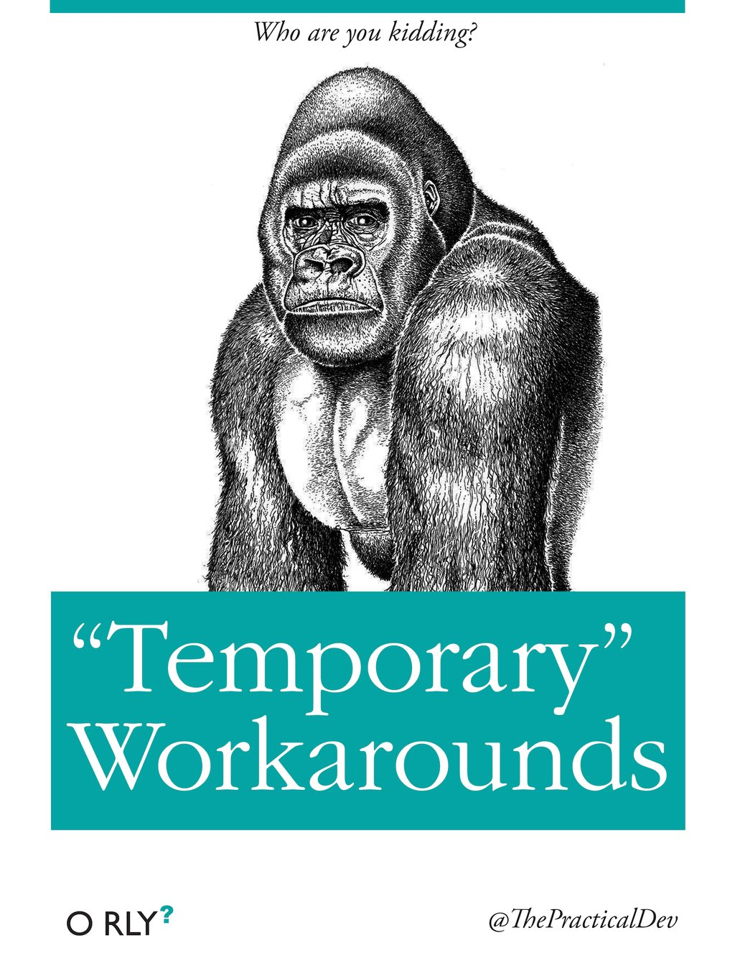

Slide 9



Slide 10



Slide 11





Slide 12

Fundamentals of Software Architecture
Architecture is the stuff you can’t Google. Everything in architecture is a trade-off, which is why the famous answer to every architecture question in the universe is “it depends.”
You cannot Google the answer to whether REST or messaging would be better, or whether microservices is the right architecture style, because it does depend. It depends on the deployment environment, business drivers, company culture, budgets, timeframes, developer skill set, and dozens of other factors. Everyone’s environment, situation, and problem is different, hence why architecture is so hard.
There are no right or wrong answers in architecture — only trade-offs.

Slide 13
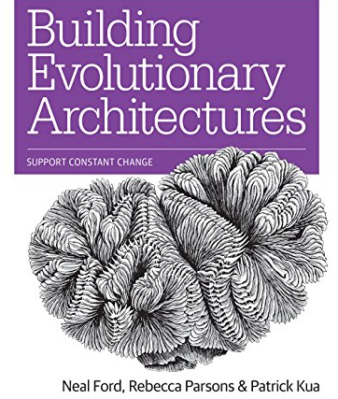
Building Evolutionary Architectures
The software development ecosystem is constantly changing, providing a constant stream of new tools, frameworks, techniques, and paradigms.
Over the past few years, incremental developments in core engineering practices for software development have created the foundations for rethinking how architecture changes over time, along with ways to protect important architectural characteristics as it evolves.
This practical guide ties those parts together with a new way to think about architecture and time.

Slide 14



Conferences
https://www.youtube.com/watch?v=8bEsNT7jdC4
https://www.youtube.com/watch?v=CglSFhwbI3s

Slide 15


Conferences
https://www.youtube.com/watch?v=PzEox3szeRc

Slide 16


THE TEAM
I am a hands-on software architect, trainer, and published author. I’ve been in the industry since 1985, and I have experience in the architecture and delivery of Microservices Architectures, Service-Based Architectures, and Service-Oriented Architectures in a variety of platforms and languages.
Neal Ford is Director, Software Architect, and Meme Wrangler at ThoughtWorks. His professional focus includes designing and building of large-scale enterprise applications. He is also an internationally acclaimed speaker, speaking at over 300 developer conferences worldwide, delivering more than 2000 presentations.
Mark Richards
Neal Ford
https://www.developertoarchitect.com/mark-richards.html
https://nealford.com/

Slide 17


THE TEAM
Before joining Thoughtworks in 1999, I was a researcher and college lecturer in computer science. After completing my degree, Master’s and Ph.D, I conducted research in compilers, program optimization, distributed computation, programming languages, theory of computation, machine learning and computational biology. In 2007 I became CTO, responsible for driving Thoughtworks’ excellence in technology.
He is a technology leader with 20+ years of experience having done a wide variety of roles including being a developer, tech lead, consultant, CTO and more. His current mission is accelerating the growth of technical leaders through coaching, mentoring and training.
Rebecca Parsons
Patrick Kua
https://www.thoughtworks.com/profiles/leaders/rebecca-parsons
https://www.patkua.com/about/

Slide 18
01
02
Software architecture
Fitness Functions
03
04
Architecture Styles
Conclusion
Definition, structure, characteristics, decisions, design principles and antipatterns, challenges, evolutionary, multi-dimensions, ....
Cohesion, coupling, abstractness, instability, distance from the main sequence, cyclic dependencies.
Layered, microkernel, service-based, event-driven, microservices, …
Lessons learned & summary.

Slide 19
01
SOFTWARE ARCHITECTURE
Characteristics of an evolutionary architecture

Slide 20
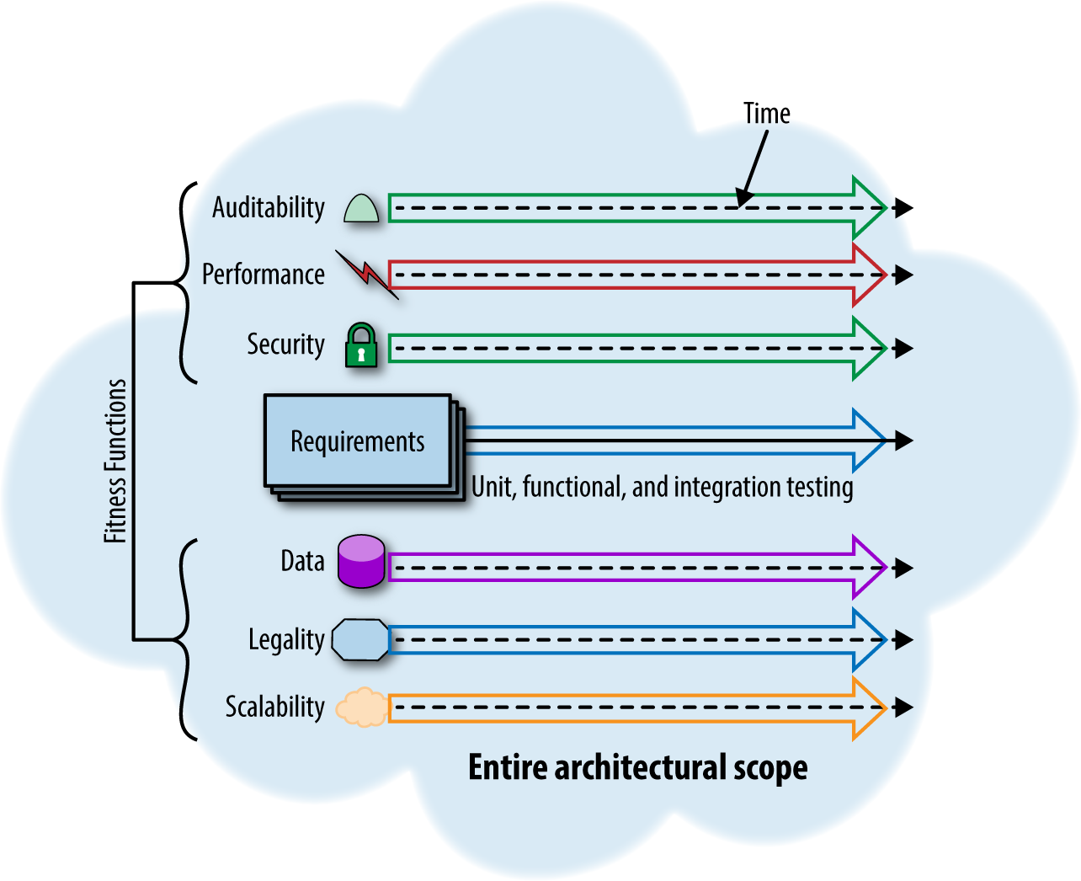
Defining software architecture
We define software architecture in terms beyond structural scaffolding, incorporating principles, characteristics, and so on.

Slide 21
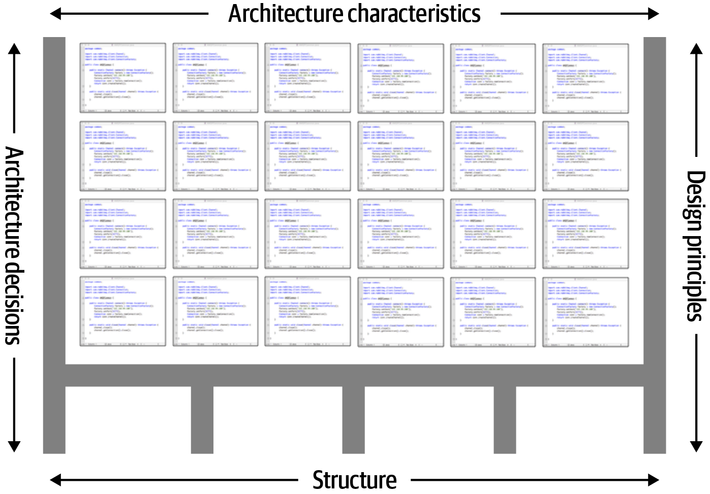
Defining software architecture
Architecture consists of the structure combined with architecture characteristics
(“-ilities”), architecture decisions, and design principles.

Slide 22
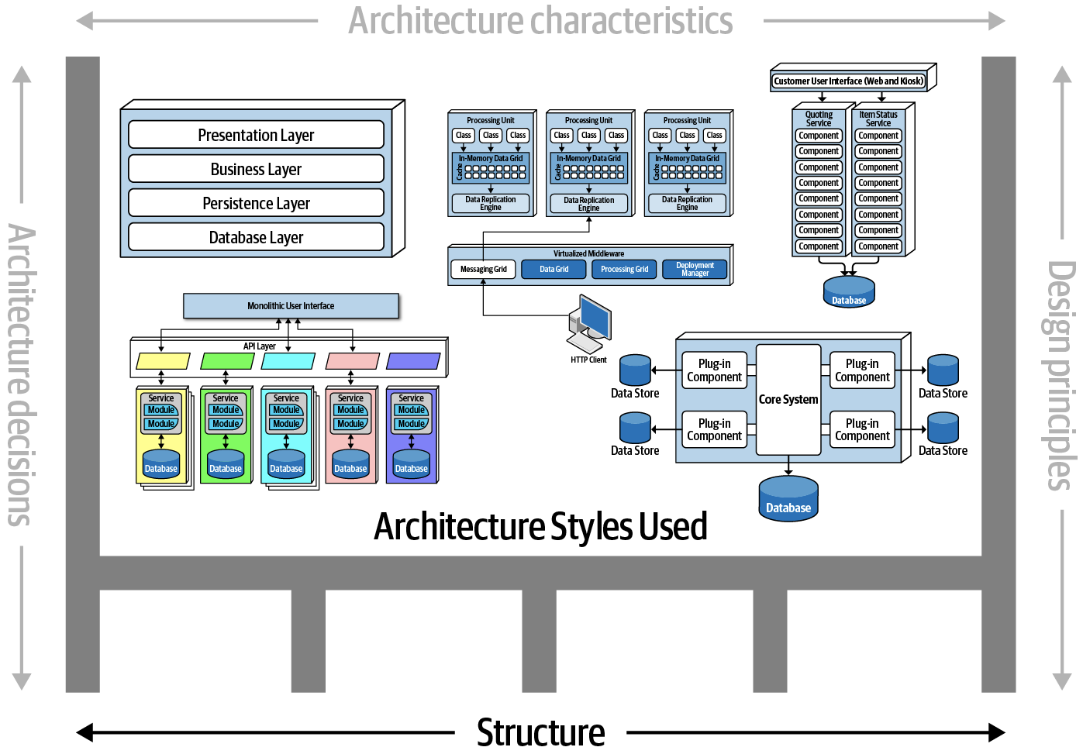
Architecture structure
The structure of the system is denoted as the heavy gray lines supporting the architecture.
The structure of the system refers to the type of architecture style (or styles) the system is implemented in (such as microservices, layered, or microkernel).

Slide 23
— Fundamentals of Software Architecture: An Engineering Approach
Describing an architecture solely by the structure does not wholly elucidate an architecture.
For example, suppose you're asked to describe an architecture, and you respond “it’s a microservices architecture.”
Here, you're only talking about the structure of the system, but not the architecture of the system.
Knowledge of the architecture characteristics, architecture decisions, and design principles is also needed to fully understand the architecture of the system.

Slide 24
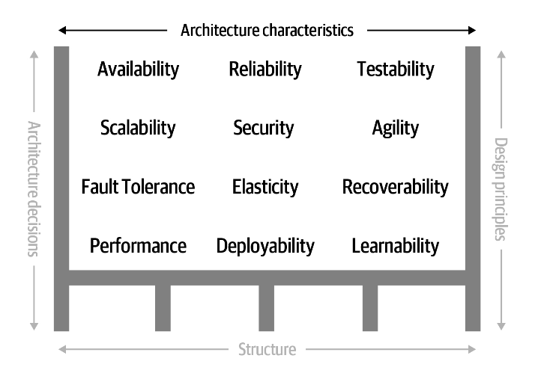
Architecture characteristics (-ilities)
The architecture characteristics define the success criteria of a system.
They are classified into three types: operational, structural and cross-cutting.

Slide 25
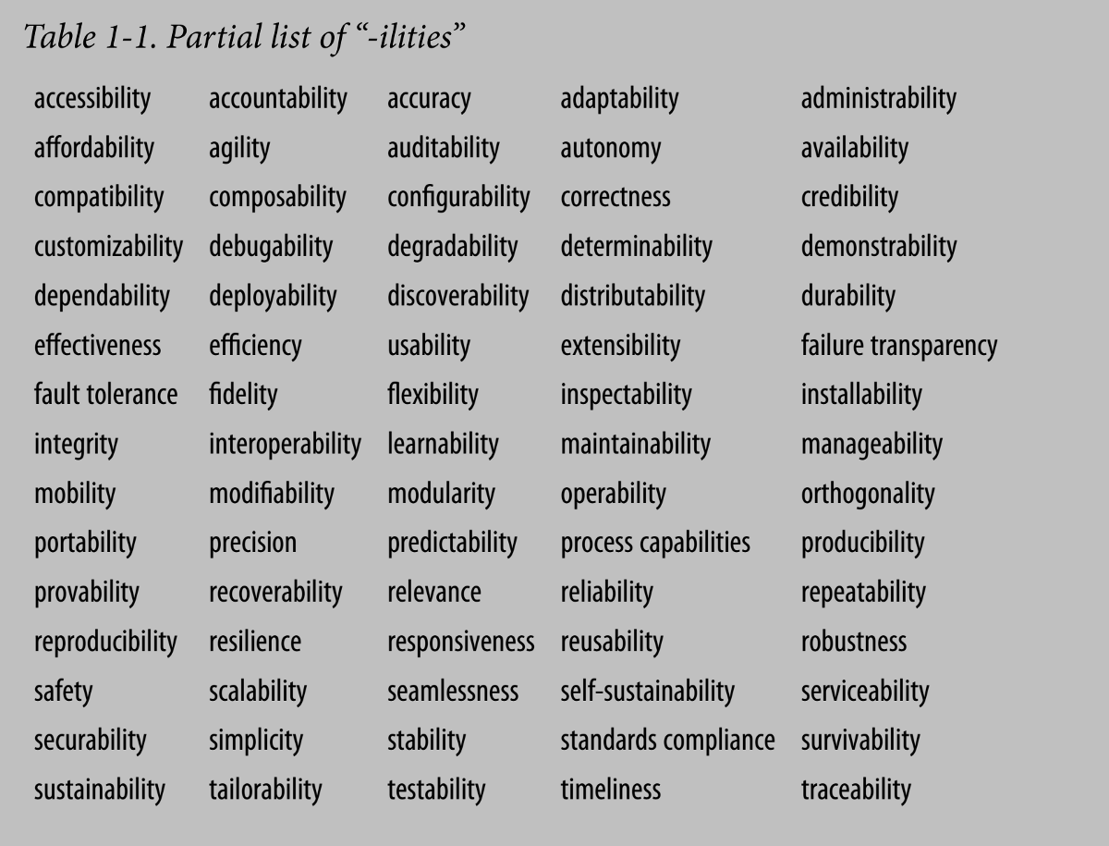
Architecture characteristics (-ilities)
Learnability: how easy users can learn how to use the software.
Usability: users can use the system effectively, efficiently, and satisfactorily for its intended purpose.
Maintainability: the degree of effectiveness and efficiency to which developers can modify the software to improve it, correct it, or adapt it to changes in environment and/or requirements.
Modularity: degree to which the software is composed of discrete components.
Reusability: degree to which developers can use an asset in more than one system or in building other assets.

Slide 26
Architecture characteristics (-ilities)
Analyzability: how easily developers can gather concrete metrics about the software.
Modifiability: degree to which developers can modify the software without introducing defects or degrading existing product quality.
Testability: how easily developers and others can test the software.
Extensibility: how easily to plug new pieces of functionality in.
Upgradeability: ability to easily/quickly upgrade the software (dependencies, languages, dico, settings, …).
Performance
Security

Slide 27

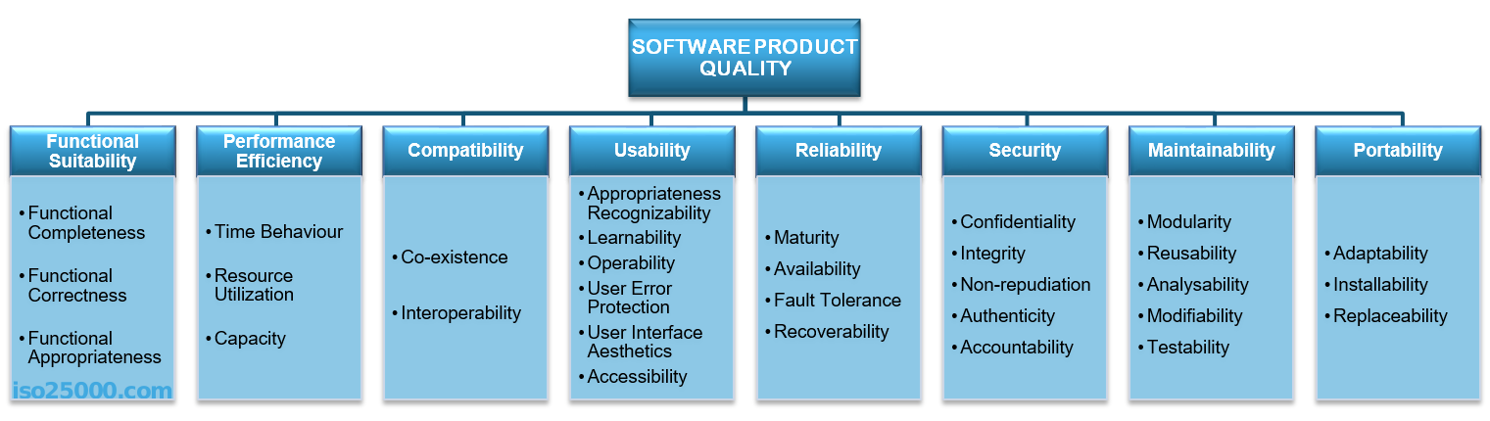

Slide 28
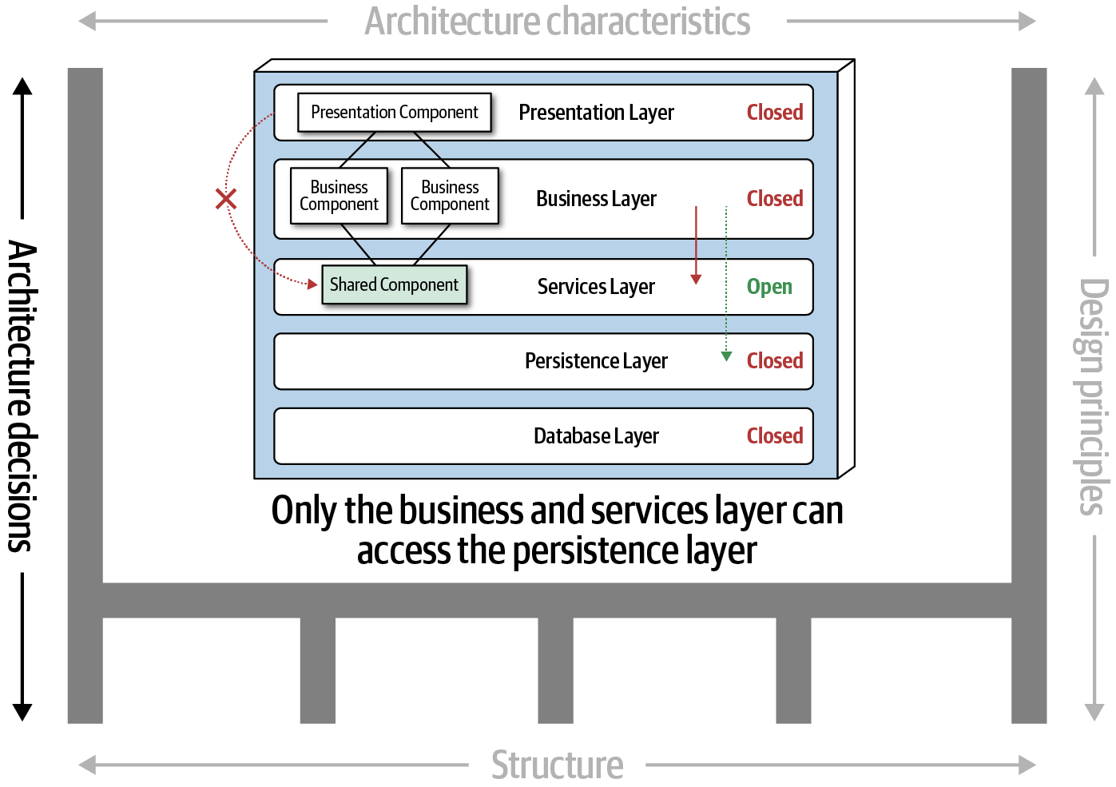
Architecture decisions
Architecture decisions define the rules for how a system should be constructed.
For example, making an architecture decision that only the business and services layers within a layered architecture can access the database, restricting the presentation layer from making direct database calls.
Architecture decisions form the constraints of the system and direct the development teams on what is and what isn’t allowed.

Slide 29
Architecture decisions
Architecture Decision Records
« One of most effective ways of documenting architecture decisions is through ADRs. »
https://cognitect.com/blog/2011/11/15/documenting-architecture-decisions
https://github.com/npryce/adr-tools

Slide 30
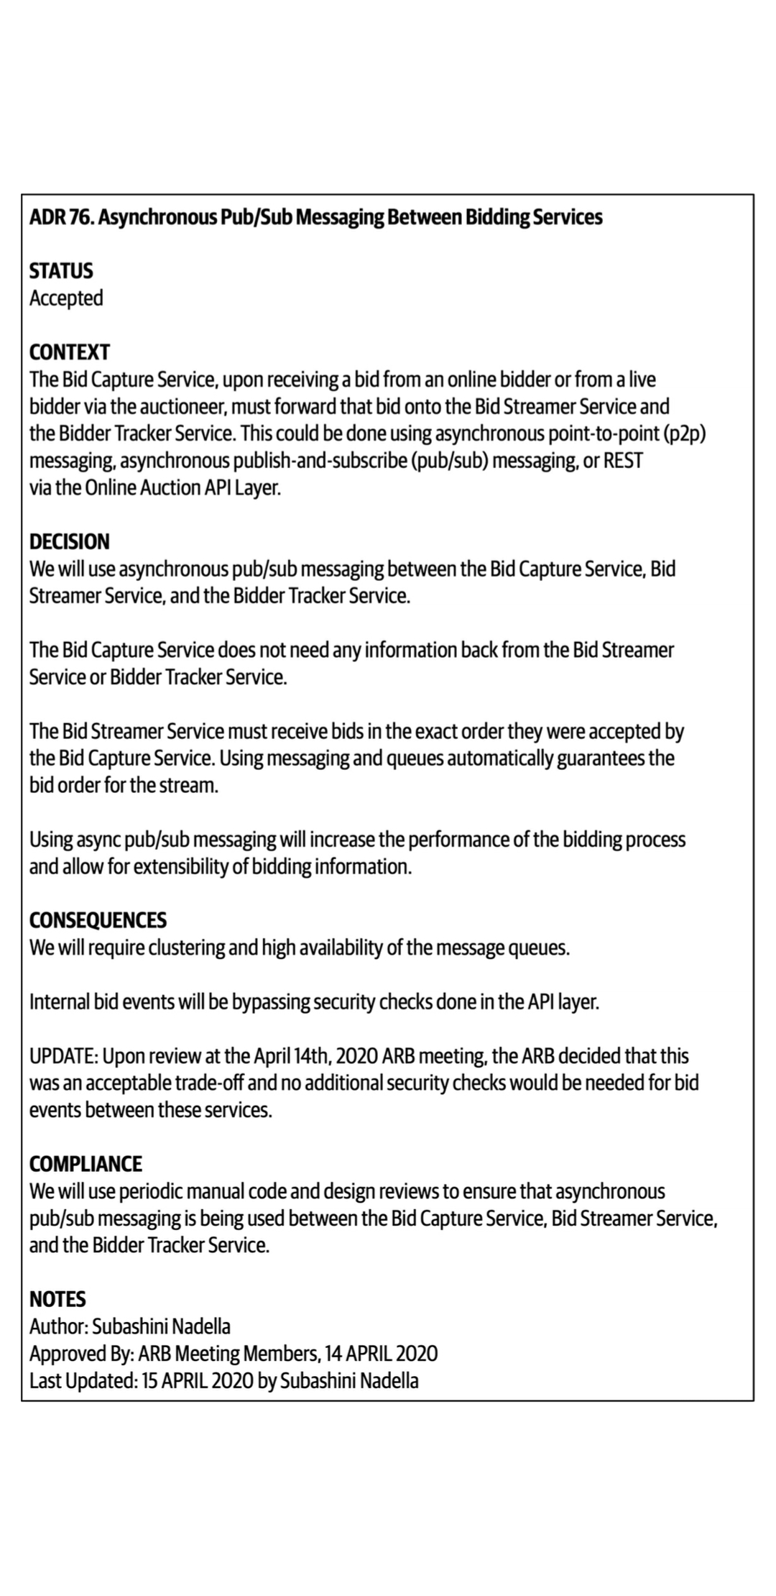
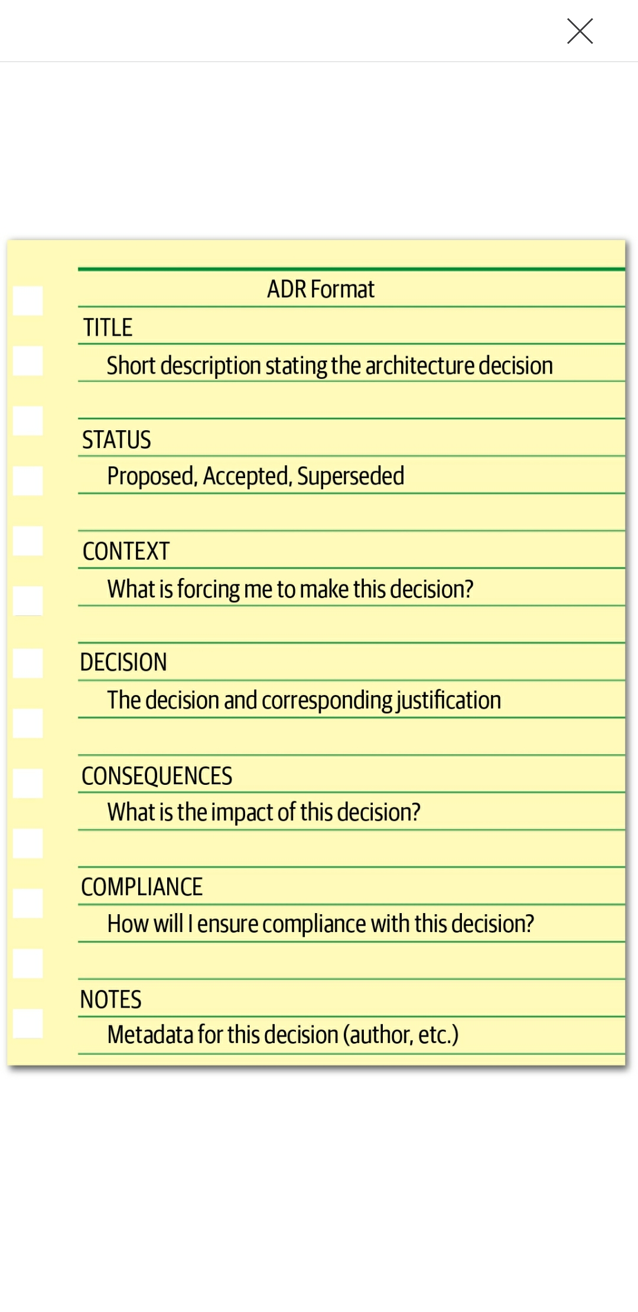
Architecture Decision Records

Slide 31
Architecture decisions antipatterns
Occurs when people don’t know why a decision was made, so keeps getting discussed over and over and over (fail to provide a justification for a decision or a complete justification).
Covering your assets
Groundhog Day
Email-Driven architecture
Avoid or differ making an architecture decision out of fear of making the wrong choice (wait until the last responsible moment, analysis paralysis, …).
Where people lose, forget, or don’t even know an architecture decision has been made.
This anti-pattern is all about effectively communicating your architecture decisions.

Slide 32
Communicating architecture decisions
A better approach is to mention only the nature and context of the decision in the body of the email and provide a link to the single system of record for the actual architecture decision and corresponding details (whether it be a link to a wiki page or a document in a filesystem). The second rule of effectively communicating architecture decisions is to only notify those people who really care about the architecture decision.

Slide 33
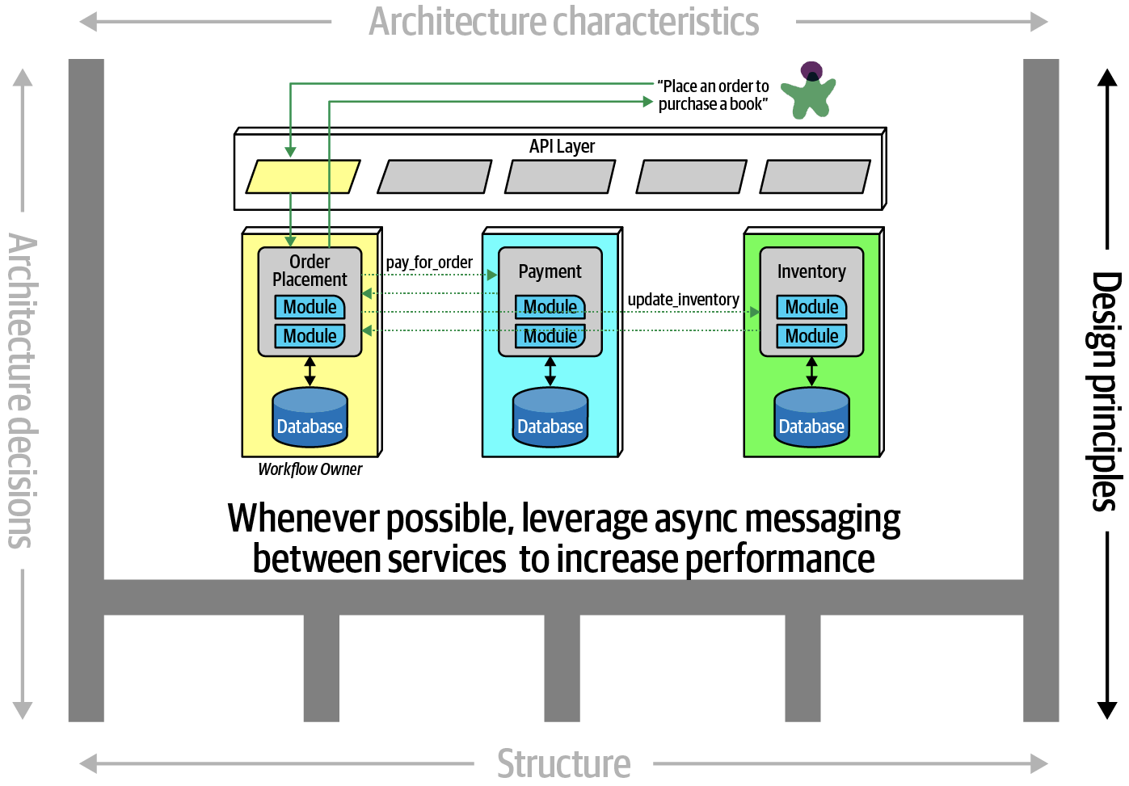
Architecture design principles
A design principle differs from an architecture decision in that a design principle is a guideline rather than a hard-and-fast rule.

Slide 34
Architecture Laws
First Law of Software Architecture: Everything in software architecture is a trade-off
Nothing exists on a nice and clean spectrum.
Every decision must take into account many opposing factors.
If you think that you have discovered something that isn’t a trade-off, more likely you just haven’t identified the trade-off yet.
Second Law of Software Architecture: Why is more important than how

Slide 35
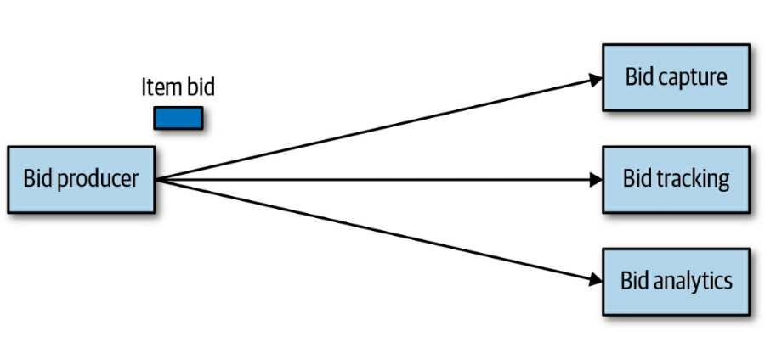
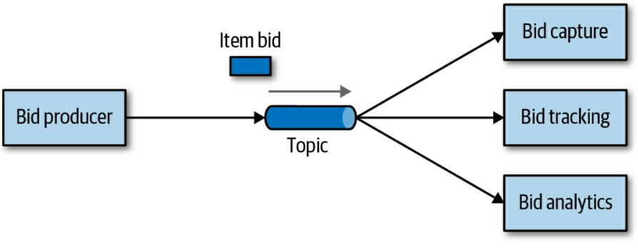
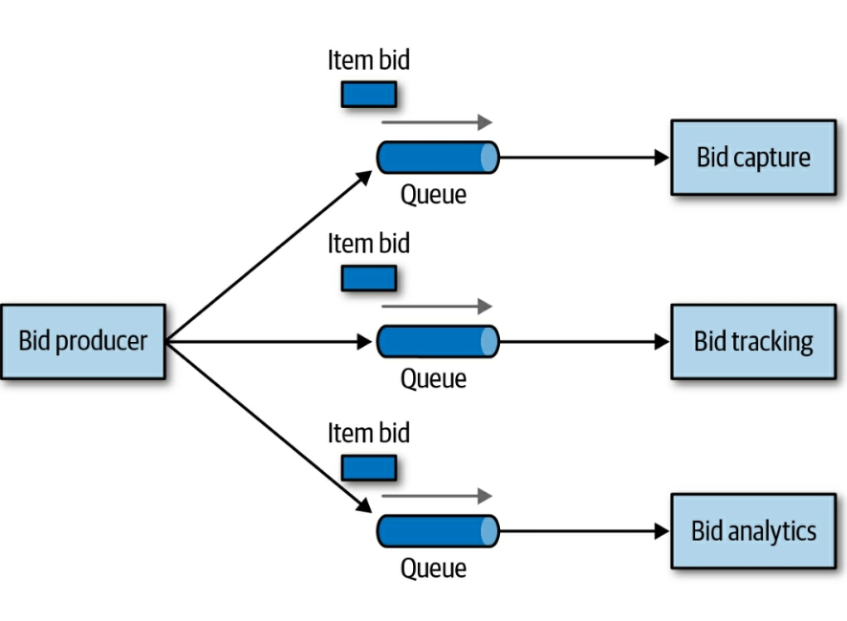
Analyzing trade-offs
2
Publish-subscribe messaging
1
Point-to-point messaging

Slide 36
Analyzing trade-offs
Which solution should we use ?

Slide 37
— Fundamentals of Software Architecture: An Engineering Approach
“You can’t Google the answer. Architectural thinking requires analyzing the trade-offs associated with each option and select the best one given the specific situation.”

Slide 38
Analyzing trade-offs
Point-to-point | Publish-subscribe
+ Extensibility: if new service called «Bid History» were to be added to this system, no changes at all would be needed to the existing system. | - Extensibility: a new queue would be required for the «Bid History» service and the «Bid Producer» would need to be modified to add an additional connection to the new queue.
+ Coupling: «Bid Producer» is more decoupled. | - Coupling.
- Data Access and Security: anyone can access bidding data. | + Data Access and Security: data sent to the queue can only be accessed by the specific consumer receiving the message.
- Supports only homogeneous contracts. | + Separate channel. + Separate contract not impacting any other service.
- Monitoring: does not support monitoring the number of messages in the topic. | + Each queue can be monitored individually.
- Autoscaling capabilities. | + Autoscaling, load balancing,

Slide 39

Analyzing trade-offs
Which is more important: extensibility or security ?
The decision between different solutions will always depend on the business drivers, environment, humans, and a host of other factors.

Slide 40
Understanding business drivers
Understanding the business drivers that are required for the success of the system and translating those requirements into architecture characteristics (such as scalability, performance, and availability).

Slide 41
Architecture challenges
The future is already here …
Tools, APIs, Browsers, Ops, …

Slide 42
Architecture challenges
We need to strategically plan for the future since new things come along constantly.

Slide 43
Architecture challenges
We can’t avoid change, we need to exploit it.

Slide 44
Architecture challenges
How Is Long-term Planning Possible When Everything Changes All the Time?

Slide 45
Architecture challenges
Moving fast without breaking things …

Slide 46
Architecture challenges
Once I’ve Built an Architecture, How Can I Prevent It from Gradually Degrading Over Time?

Slide 47
Evolutionary architecture
Continual architecture: building architectures that have no end state and are designed to evolve with the ever-changing software development ecosystem, and including built-in protections around important architectural characteristics.

Slide 48
HOW ?
Extending the current software architecture definitions to adding time and change as first-class architectural elements.

Slide 49
— Building evolutionary architecture
“An evolutionary architecture supports guided, incremental changes across multiple dimensions.”

Slide 50
Incremental change
Incremental change describes two aspects of software architecture: how teams build software incrementally and how they deploy it.
During development, an architecture that allows small, incremental changes is easier to evolve because developers have a smaller scope of change.
For deployment, incremental change refers to the level of modularity and decoupling for business features and how they map to architecture.

Slide 51
Guided change
Once we have chosen important characteristics, we want to guide changes to the architecture to protect those characteristics :
Documentation.
Communication.
Fitness functions.

Slide 52
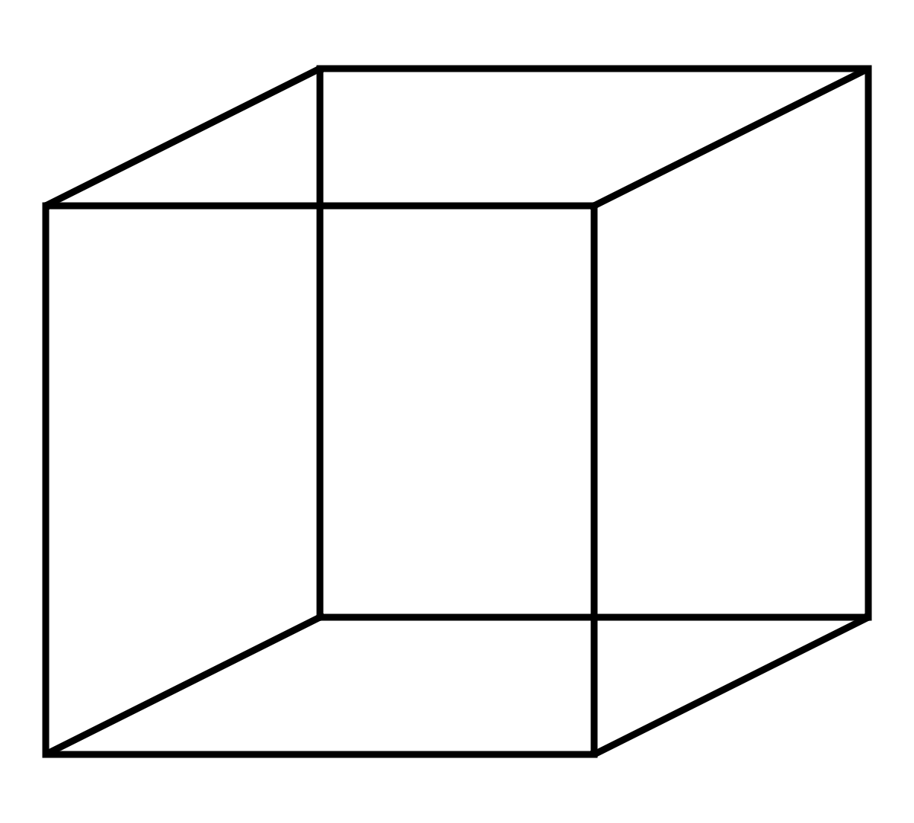
Multiple dimensions
Operational
Security
Data
Technical
Time

Slide 53
Why « evolutionary » ?
Evolutionary
Incremental
Continual
Agile
Emergent
Reactive

Slide 54
Why « evolutionary » ?
“We prefer the word evolutionary over adaptable because we are interested in architectures that undergo fundamental evolutionary change, not ones that have been patched and adapted into increasingly incomprehensible accidental. Adapting implies finding some way to make something work regardless of the elegance or longevity of the solution.”
- Building evolutionary architecture

Slide 55
FITNESS FUNCTIONS
02
Measuring architecture characteristics

Slide 56
Architecture characteristics (-ilities)

Slide 57
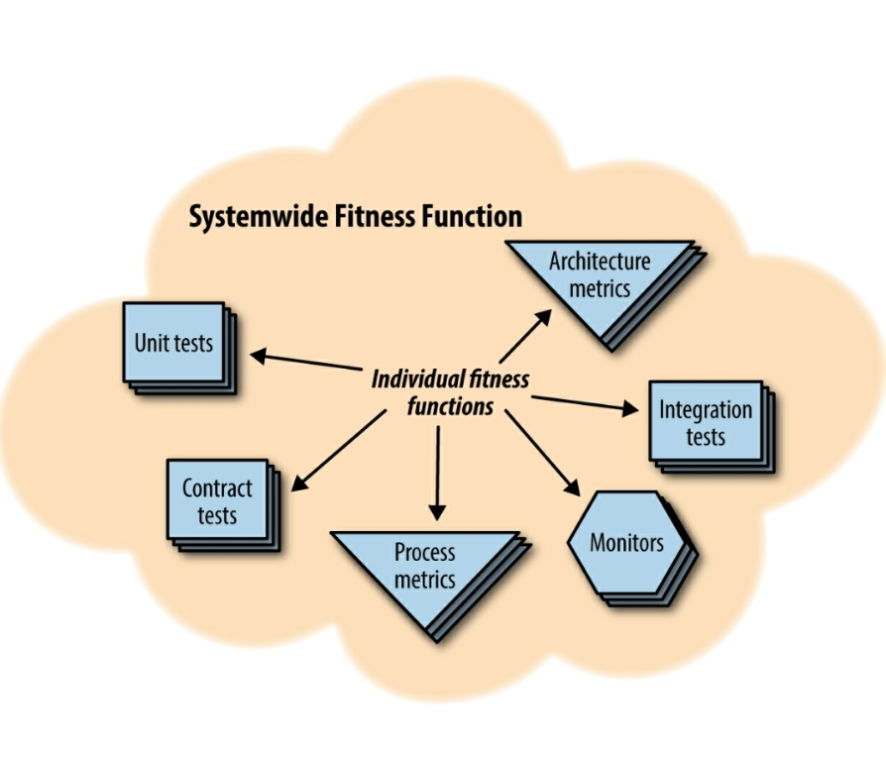
Fitness functions
Fitness functions check that we preserve important architectural characteristics.
An architectural fitness function provides an objective integrity assessment of some architectural characteristic(s).
The fitness function protects the various architectural characteristics required for the system.

Slide 58
Fitness functions - Metrics
Fitness functions
Cohesion
Coupling
Instability
Distance from the main sequence
Entropy
Cyclic dependencies
Abstractness

Slide 59
Cohesion
“In computer programming, cohesion refers to the degree to which the elements inside a module belong together.”
Customer Maintenance :
add customer
update customer
get customer
notify customer
get customer orders
cancel customer orders
Should the last two entries reside in this module or we should create two separate modules, such as: Customer Maintenance and Order Maintenance ?

Slide 60
Cohesion
Customer Maintenance :
add customer
update customer
get customer
notify customer
Customer Maintenance :
add customer
update customer
get customer
notify customer
get customer orders
cancel customer orders
Order Maintenance :
get customer orders
cancel customer orders

Slide 61
Cohesion
Which is the correct structure ? As always, it depends !

Slide 62
Cohesion
Are those the only two operations for Order Maintenance? If so, it may make sense to collapse those operations back into Customer Maintenance.
Is Customer Maintenance expected to grow much larger, encouraging developers to look for opportunities to extract behavior?
Does Order Maintenance require so much knowledge of Customer information that separating the two modules would require a high degree of coupling to make it functional?

Slide 63
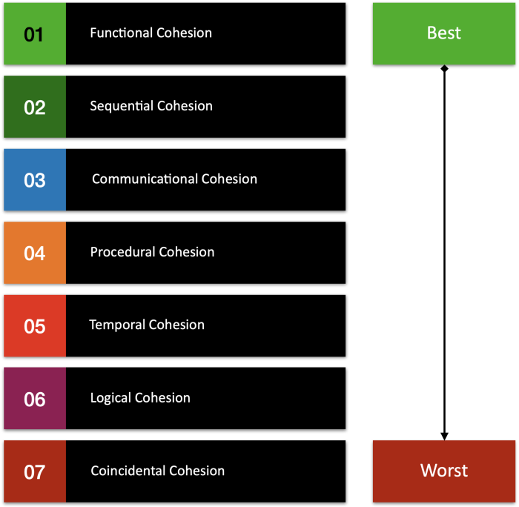
Cohesion

Slide 64
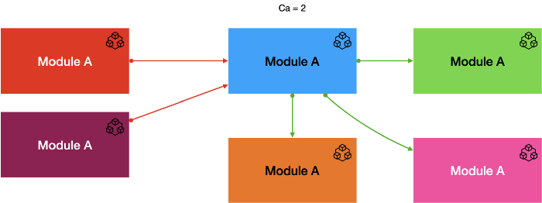

Coupling
“In software engineering, coupling is the degree of interdependence between software modules; a measure of how closely connected two routines or modules are.”
Efferent coupling (CE)
CE measures the total number of classes inside a package that depend upon classes outside of the package.
CA measures the total number of classes outside of a package that depend upon classes within that package.
Afferent coupling (CA)

Slide 65
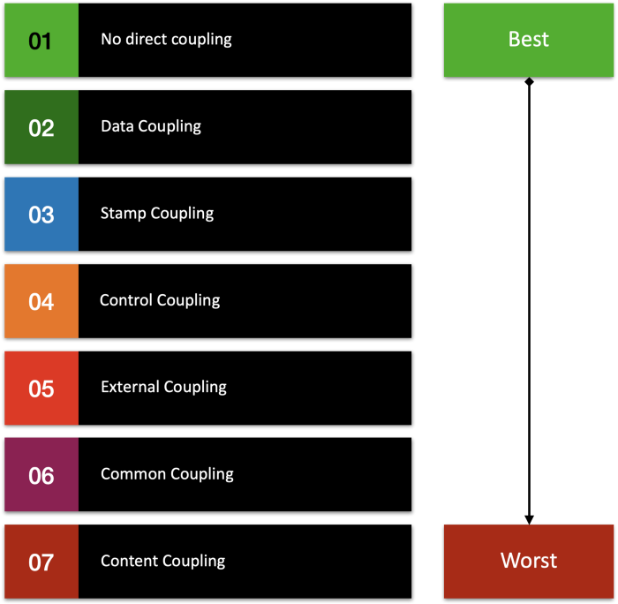
Coupling

Slide 66
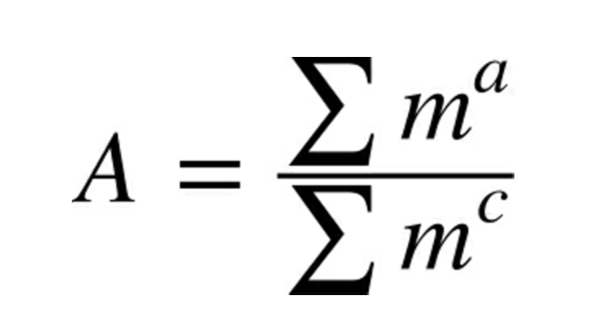
Abstractness
Abstractness is the ratio of abstract artifacts (abstract classes, interfaces, and so on) to concrete artifacts (implementation).
It represents a measure of abstractness versus implementation.
Consider an application with 5,000 lines of code, all in one main() method.
The abstractness numerator is 1, while the denominator is 5,000, yielding an abstractness of almost 0.

Slide 67
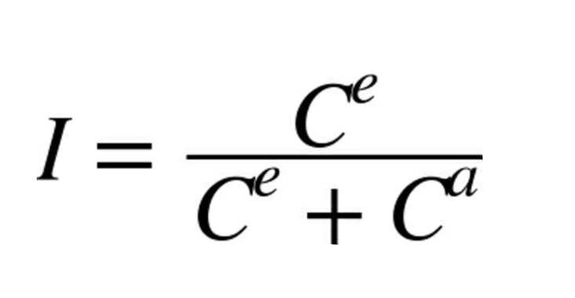
Instability
This metric measures the instability of packages, where stability is measured by calculating the effort to change a package without impacting other packages within the application.
This metric produces results in the range [0, 1]:
A value I=0 indicates a maximally stable package that depends upon nothing.
I=1 indicates a total Instable package that has no incoming dependencies but depends upon other packages.
Instability negatively influences re-usability, maintainability and portability.

Slide 68
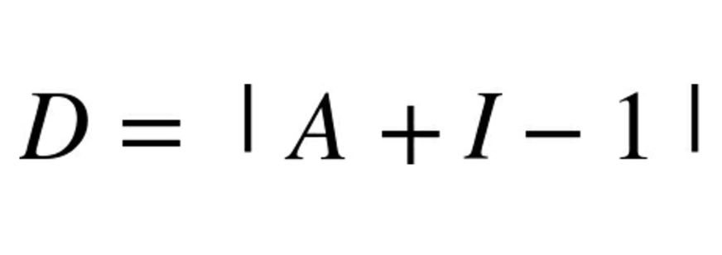
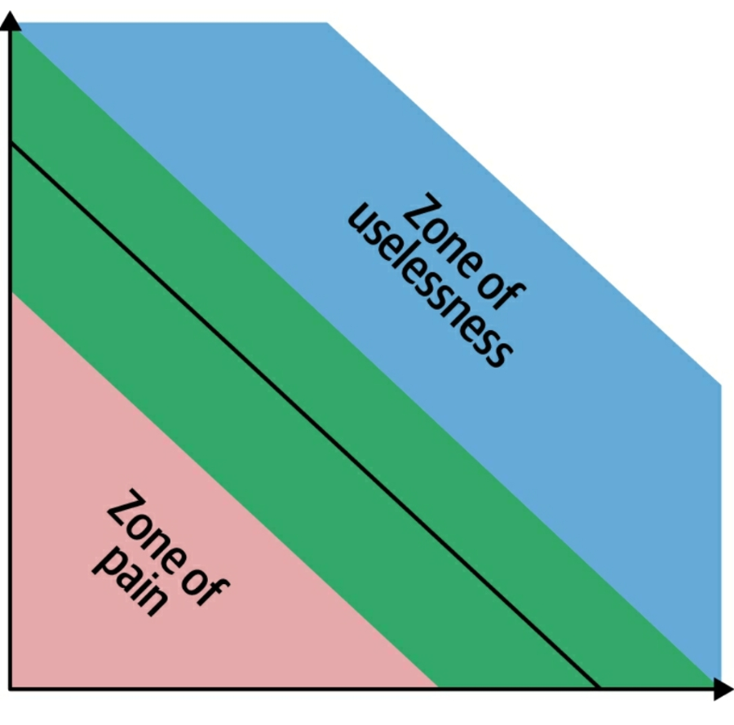
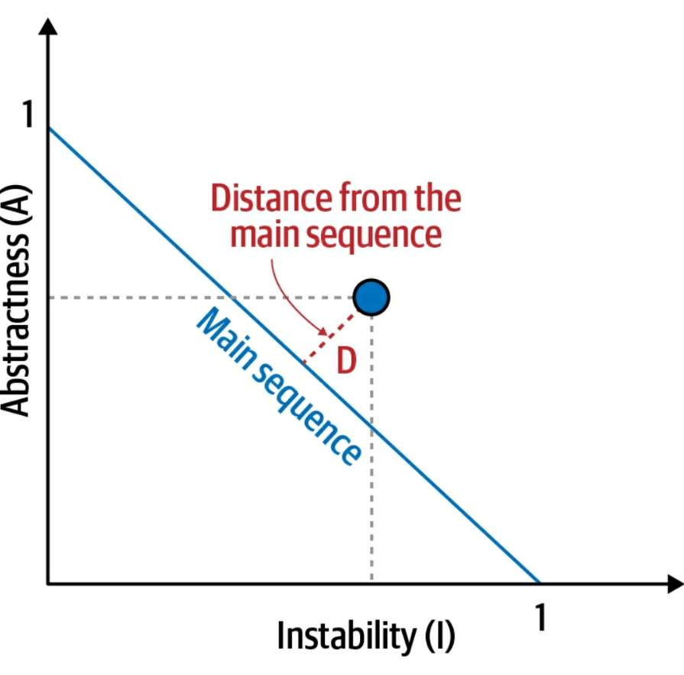
Distance from the main sequence

Slide 69
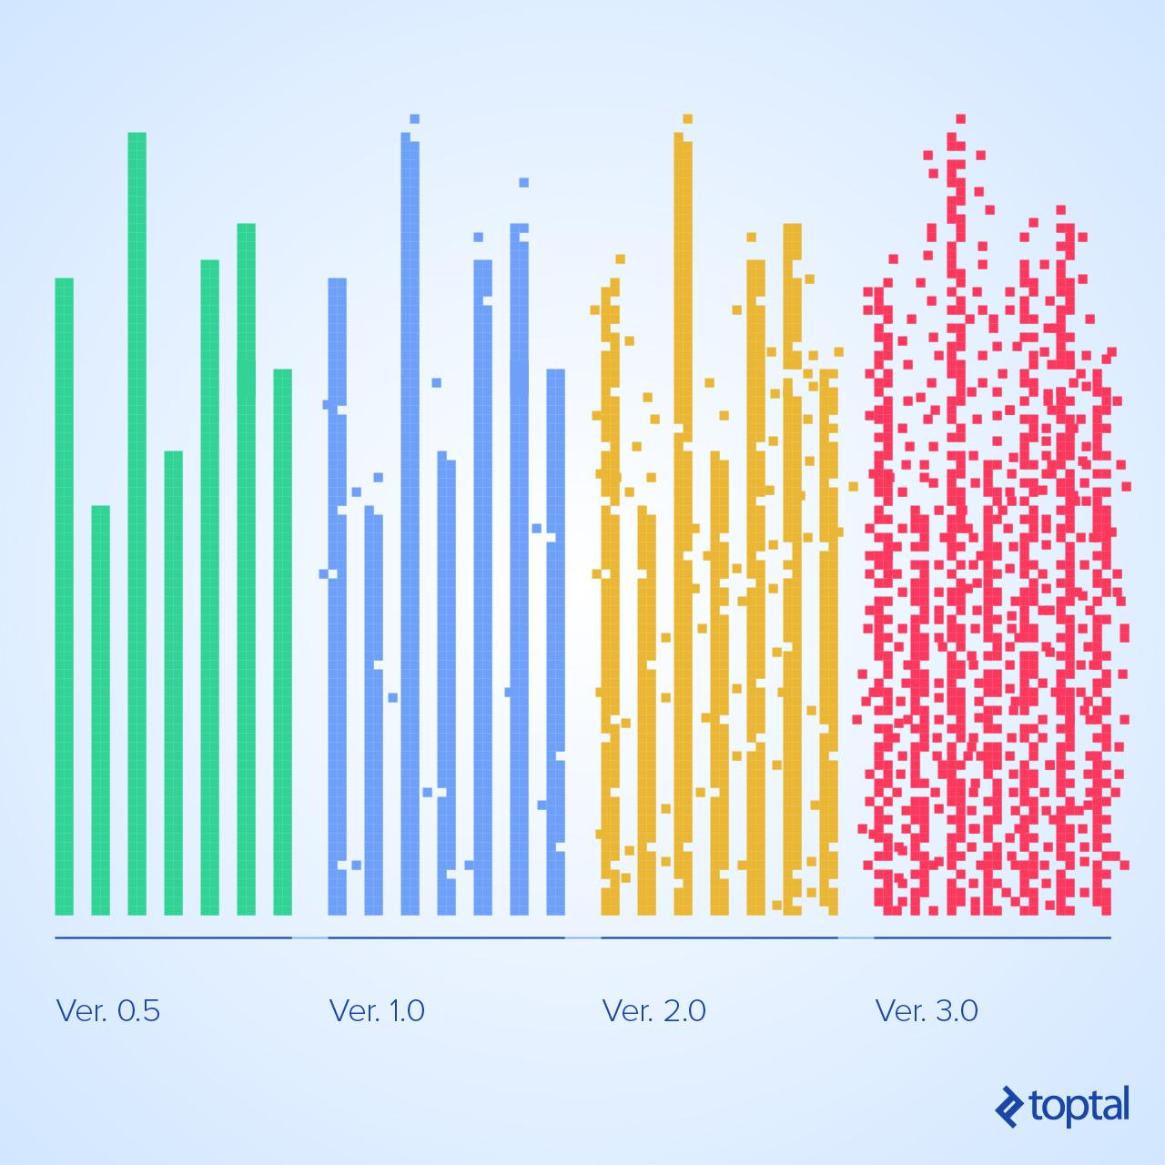
Entropy
"The second law of thermodynamics, in principle, states that a closed system's disorder cannot be reduced, it can only remain unchanged or increase. A measure of this disorder is entropy. This law also seems plausible for software systems; as a system is modified, its disorder, or entropy, tends to increase. This is known as software entropy."

Slide 70
Halstead metrics
main(){ int a, b, c, avg; scanf("%d %d %d", &a, &b, &c); avg = (a + b + c) / 3; printf("avg = %d", avg); } The unique operators are: main, (), {}, int, scanf, &, =, +, /, printf, ,, ; The unique operands are: a, b, c, avg, "%d %d %d", 3, "avg = %d" n1 = 12, n2 = 7, n = 19 N1 = 27, N2 = 15, N = 42 V = 42 * log2(19) = 178.4 D = 12/2 * 15/7 = 12.85 E = 12.85 * 178.4 = 2292.44 T = 2292.44/18 = 127.357 seconds B = 0.05
For a given function, consider :
n1 = the number of distinct operators
n2 = the number of distinct operands
N1 = the total number of operators
N2 = the total number of operands
From these numbers, several important measures can be calculated:
Program length (N) = N = N1 + N2
Vocabulary size (n) = n = n1 + n2
Program volume (V) = V = N * log2(n)
Difficulty level (D) = D = ( n1 / 2 ) * ( N2 / n2 )
Effort to implement (E) = E = V * D
Time to implement (T) = T = E / 18
Number of delivered bugs (B) = B = (E^2/3) / 3000
https://www.ibm.com/docs/en/rtr/8.0.0?topic=SSSHUF_8.0.0/com.ibm.rational.testrt.studio.doc/topics/csmhalstead.htm

Slide 71
Halstead metrics
Halstead’s volume (V) describes the size of the implementation of an algorithm. If the function is to remain clear and understandable, its volume must be low: low number of operators, low number of operands, and small vocabulary (small functions).
The volume of a function should be at least 20 and at most 1,000. A volume greater than 1,000 tells that the function probably does too many things.
Difficulty level (D) is proportional to the ratio between the total number of operands and the number of unique operands. If the same operands are used many times in the program, it is more prone to errors.
The effort to implement (E) or understand a program is proportional to the volume and to the difficulty level of the program. Large functions have a high (E).
The number of delivered bugs (B) estimates the number of errors in the implementation. Delivered bugs in a file should be fewer than two.

Slide 72
Halstead metrics
Halstead metrics depend closely on what we wrote and how we reasoned in terms of code (operands and operators). They measure the overall quality of the function.

Slide 73
Maintability indicator
Maintainability Index = MI = MIwoc + MIcw
MIwoc: Maintainability Index without comments
MIcw: Maintainability Index comment weight
MIwoc =171 − 5.2 * ln(V) − 0.23 * G − 16.2 * ln(L)
V is the Halstead Volume.
G is the total Cyclomatic Complexity.
L is the number of Source Lines of Code (SLOC).
MIcw = 50 * sin(√2,4 * C)
C average percent of lines of comments.
Cases of MI :
85 and more: good maintainability
65–85: moderate maintainability
< 65: difficult to maintain
https://docs.sonarqube.org/latest/user-guide/metric-definitions/

Slide 74
Security indicator
https://docs.sonarqube.org/latest/user-guide/metric-definitions/

Slide 75
Reliability indicator
https://docs.sonarqube.org/latest/user-guide/metric-definitions/

Slide 76
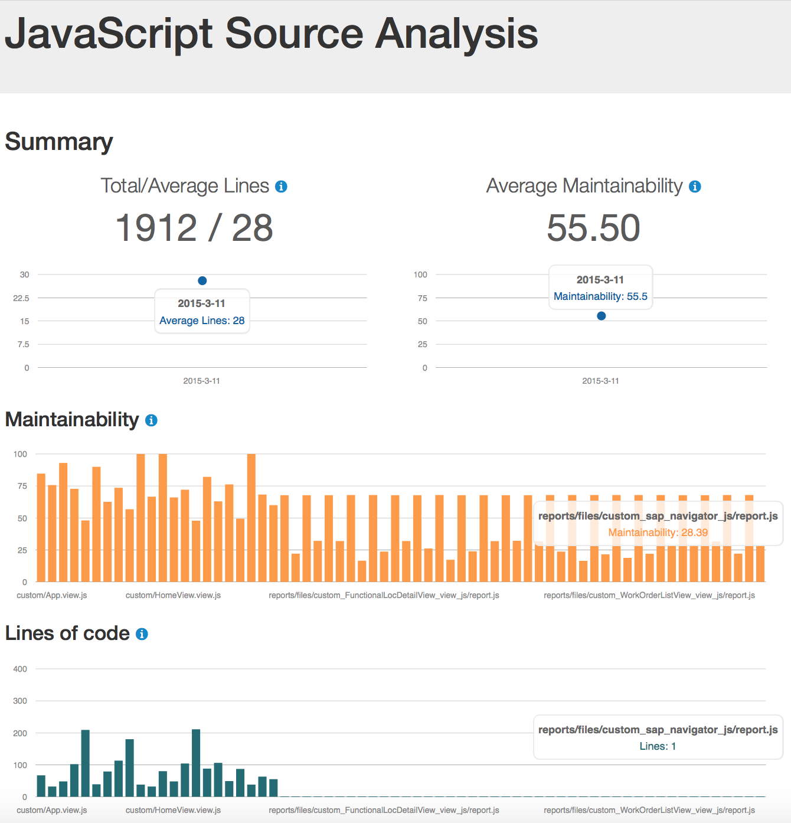




Tools

Slide 77
03
ARCHITECTURE STYLES
There are no right or wrong answers in architecture — only trade-offs.

Slide 78
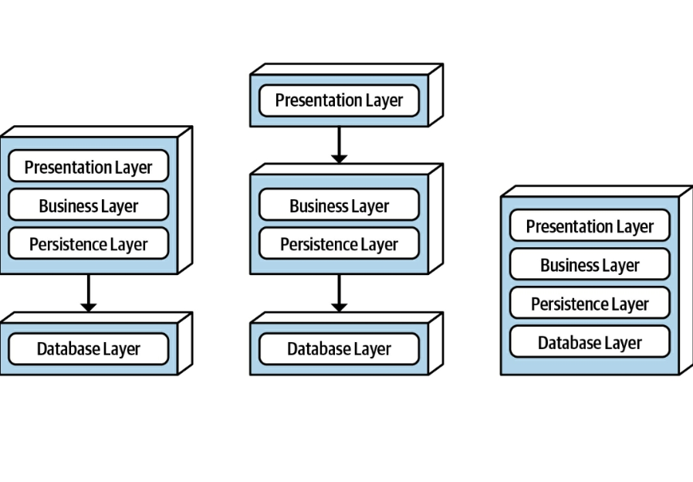
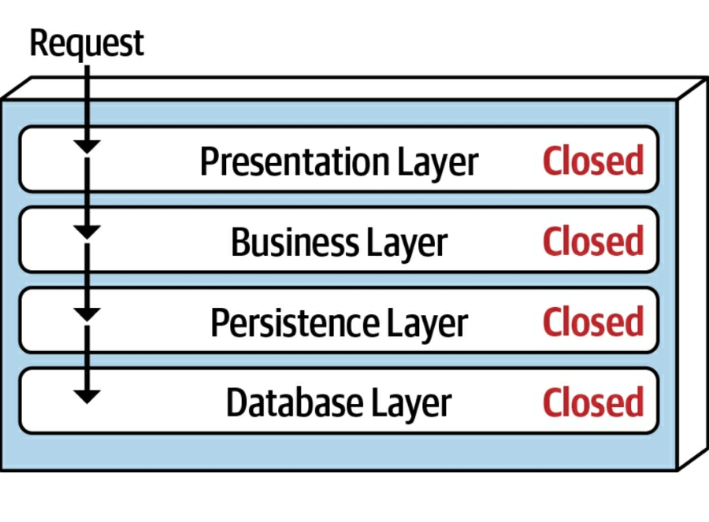
Layered architecture - topology

Slide 79
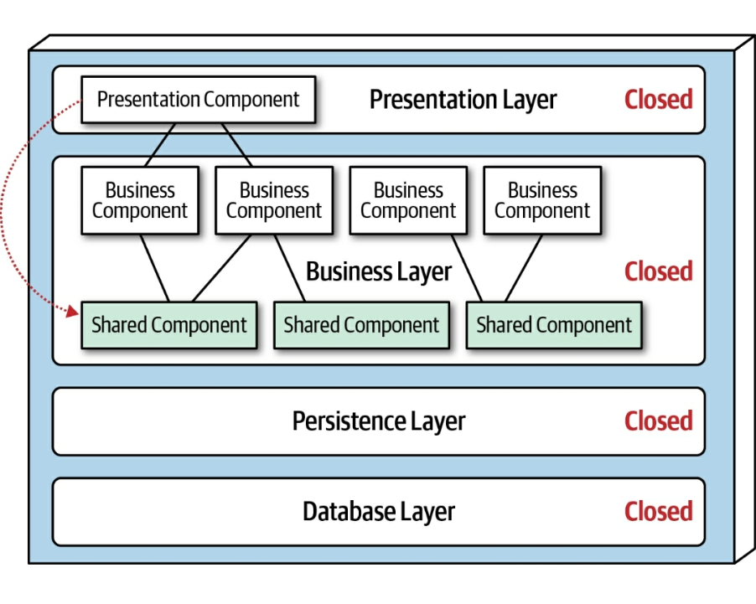
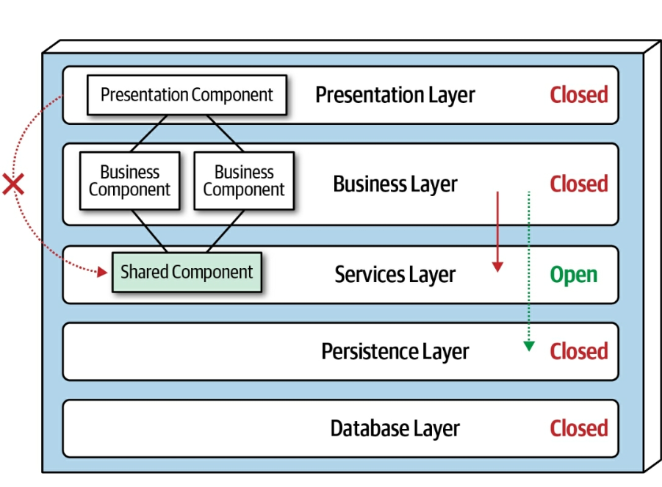
Layered architecture – adding layers

Slide 80
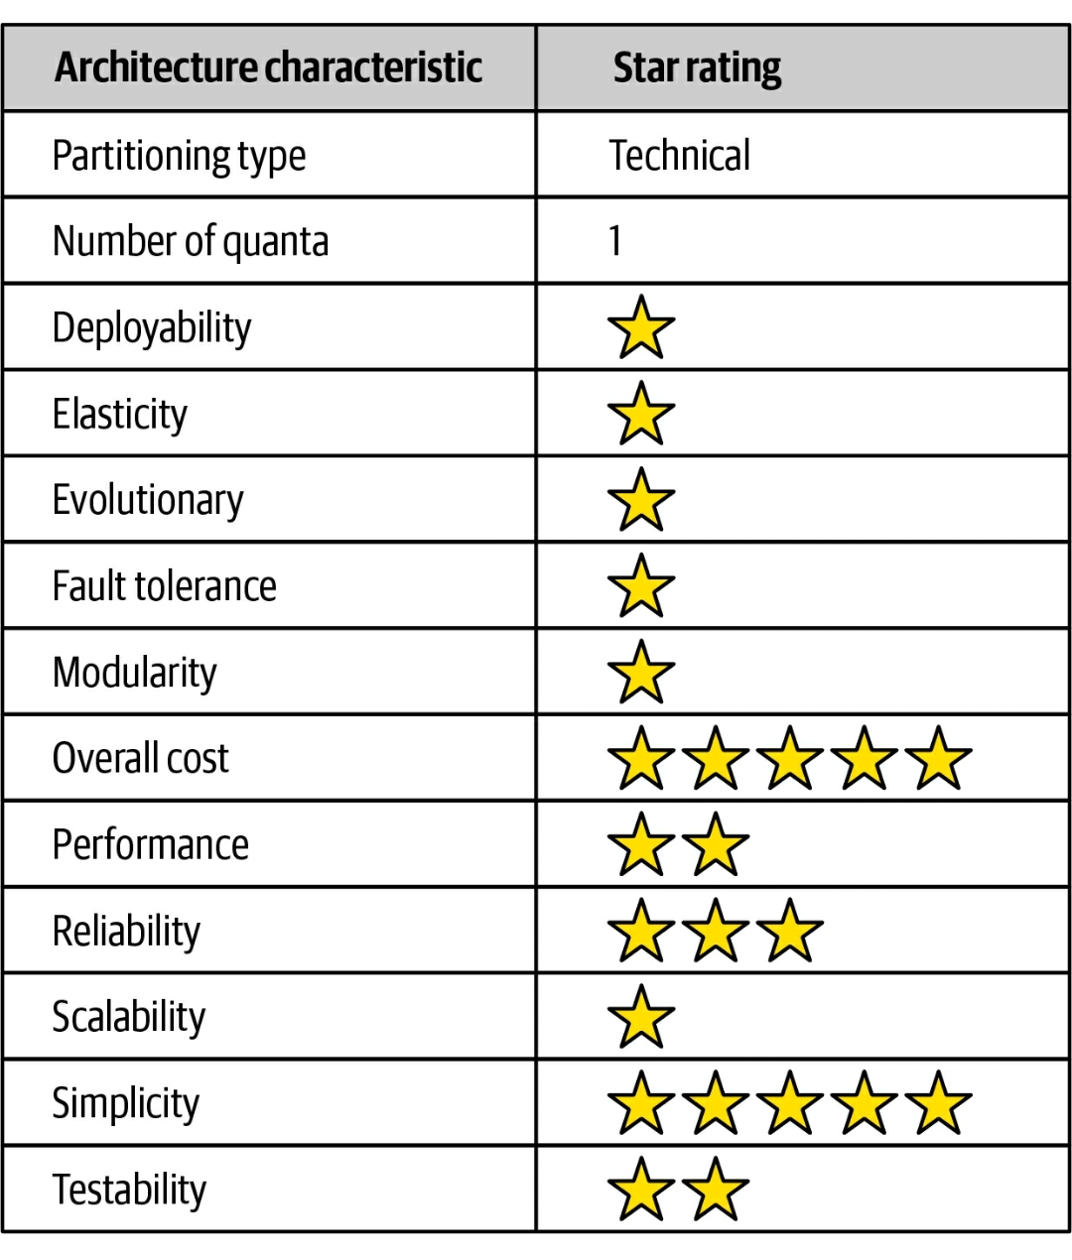
Layered architecture – rating

Slide 81
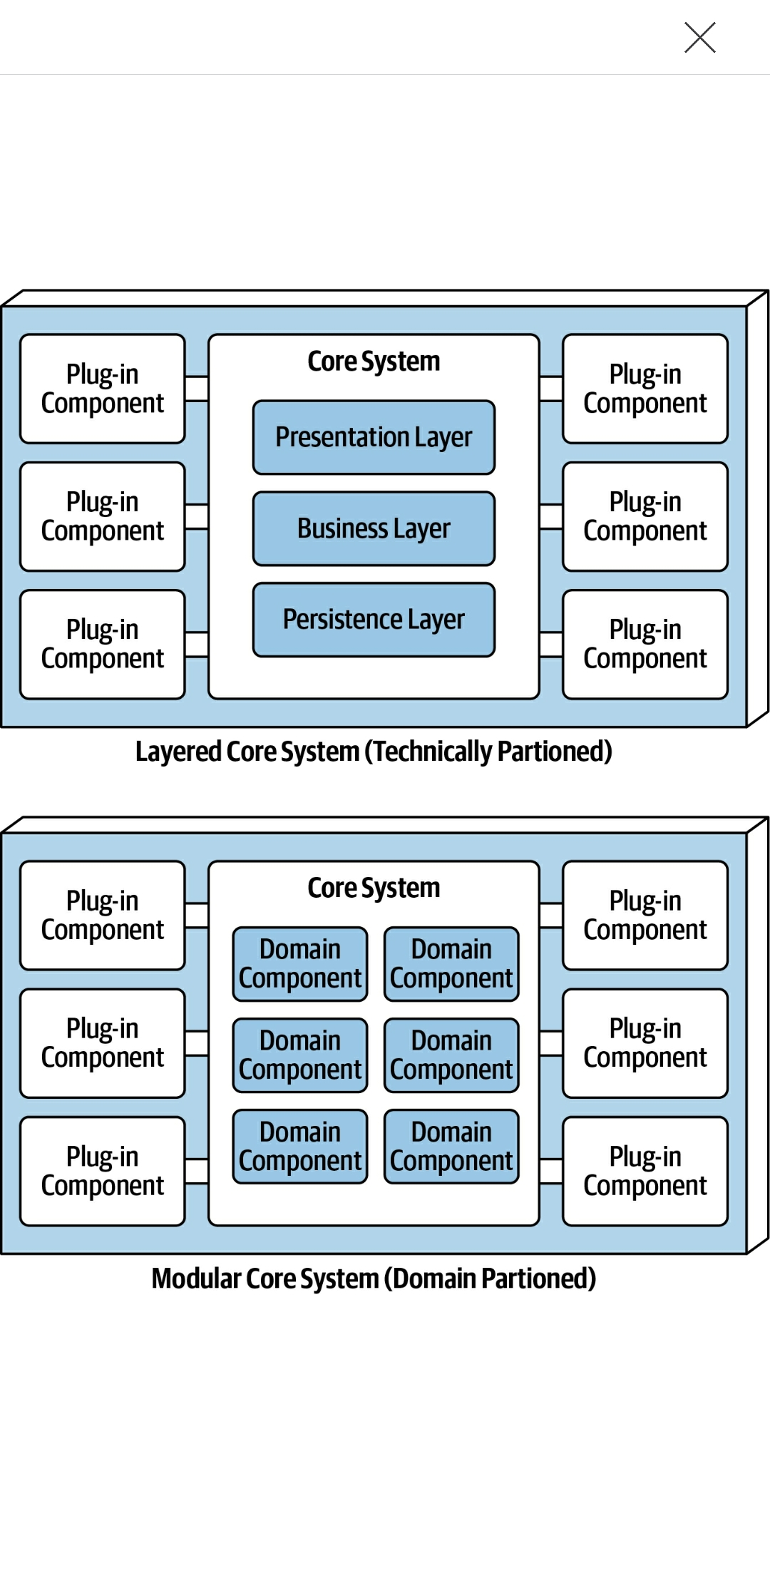
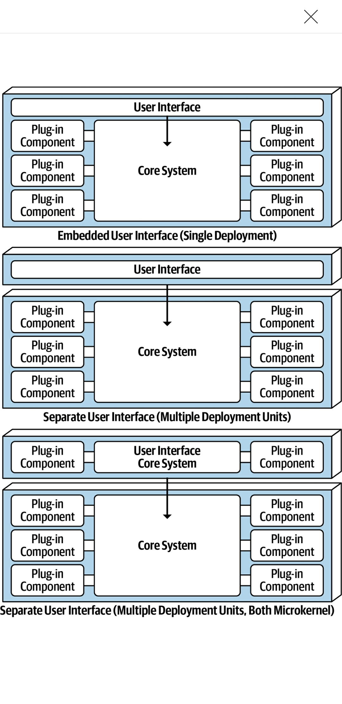
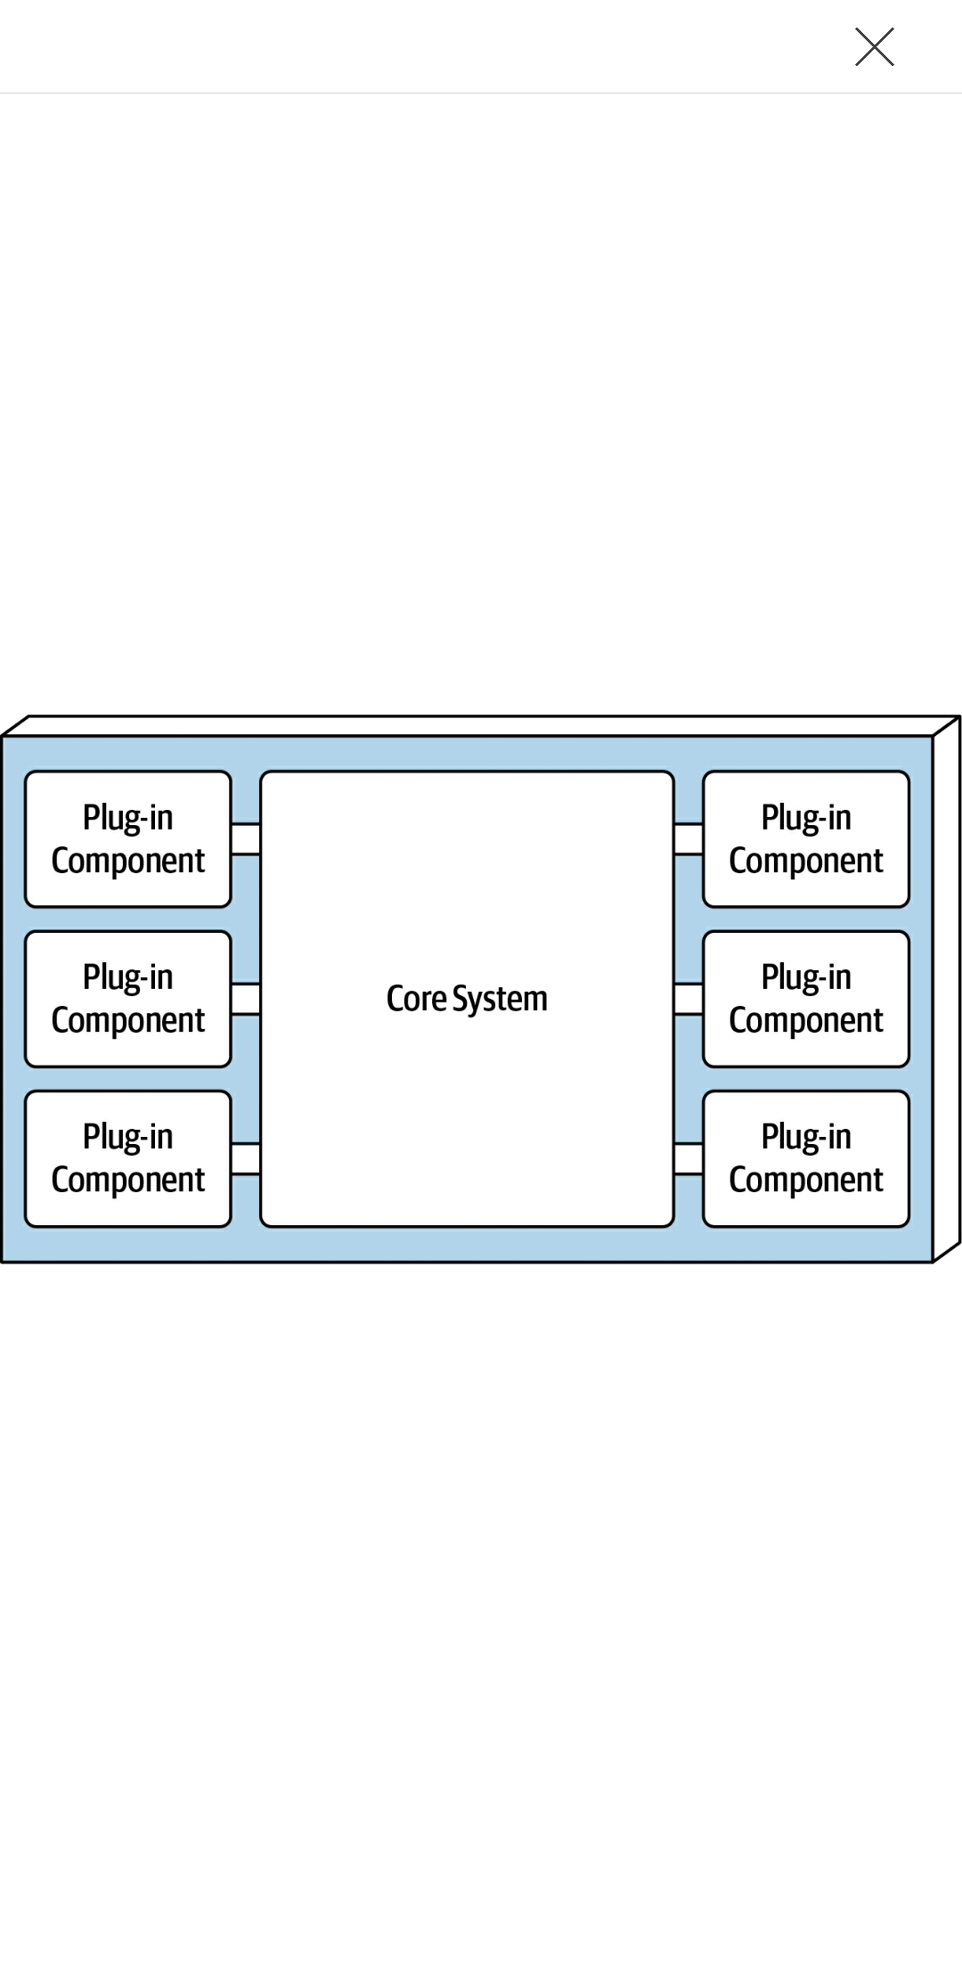
Microkernel architecture - topology

Slide 82
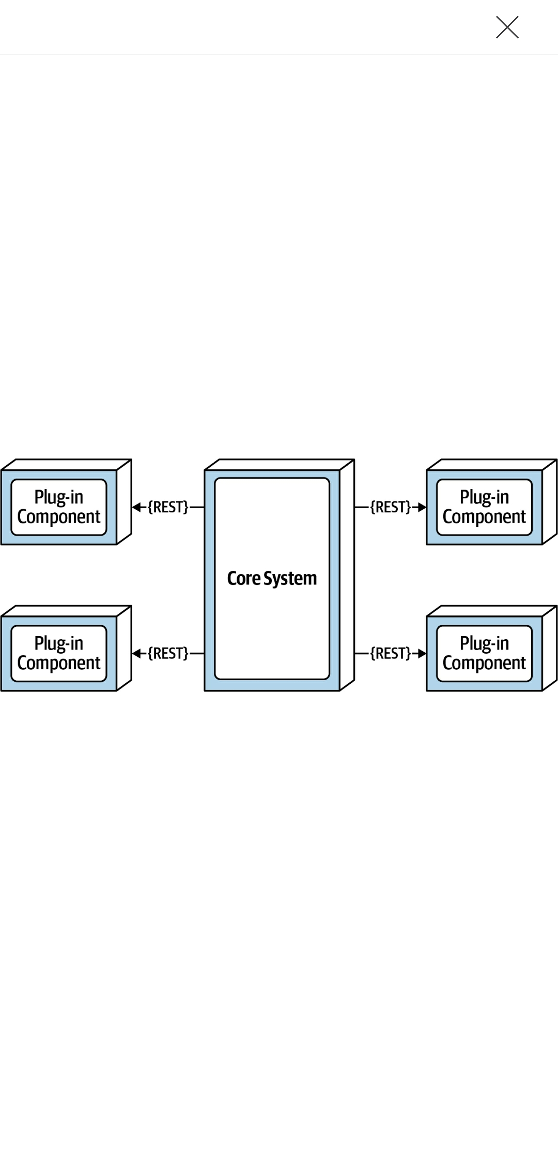
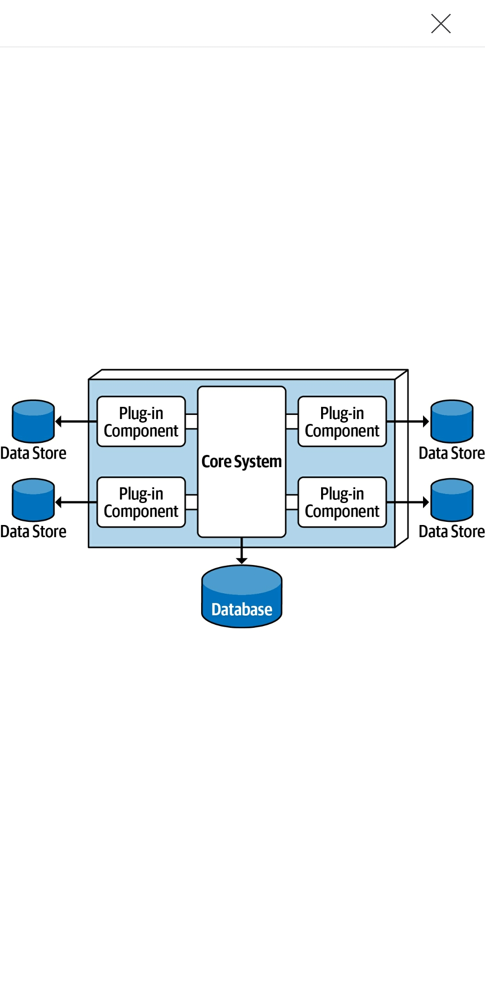
Microkernel architecture – plug-in components

Slide 83
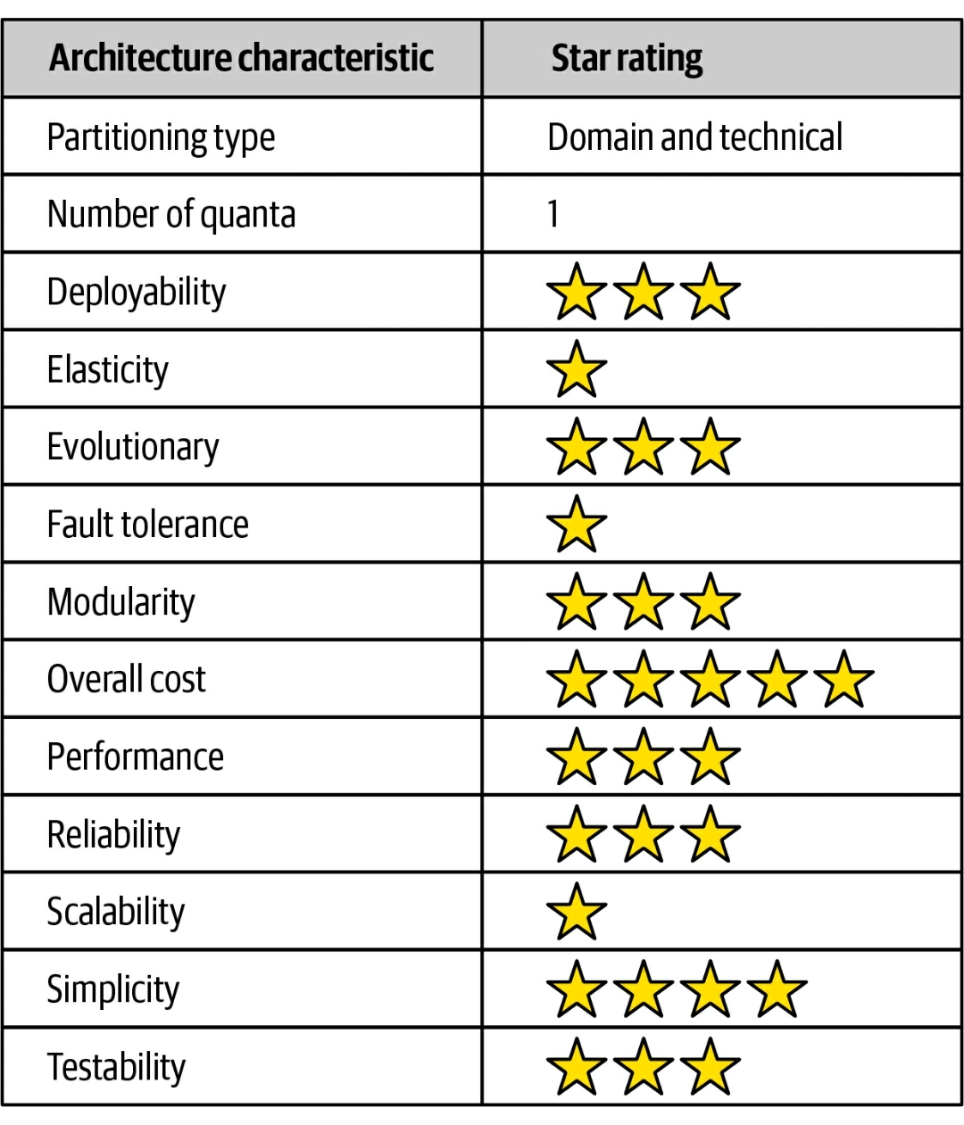
Microkernel architecture – rating

Slide 84
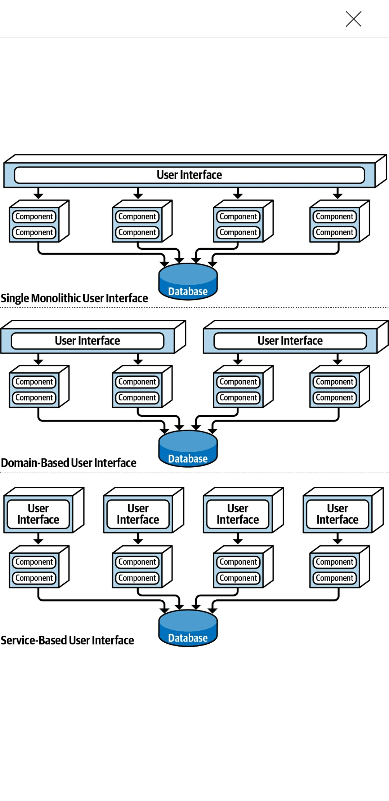
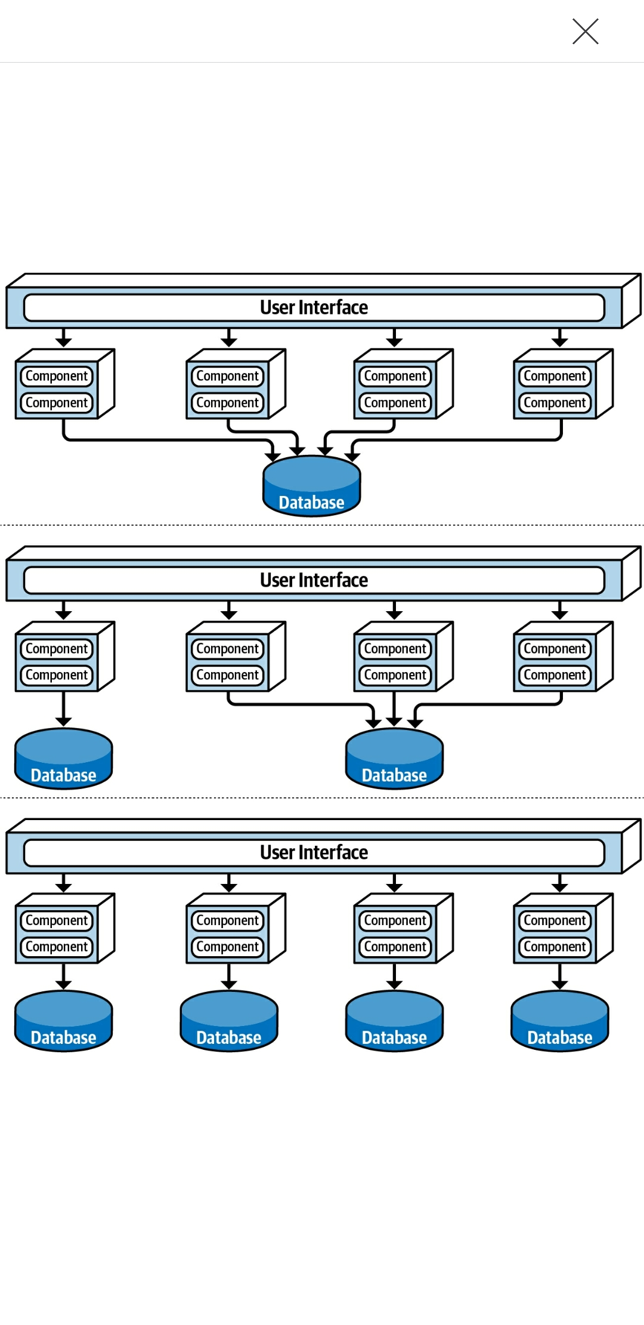
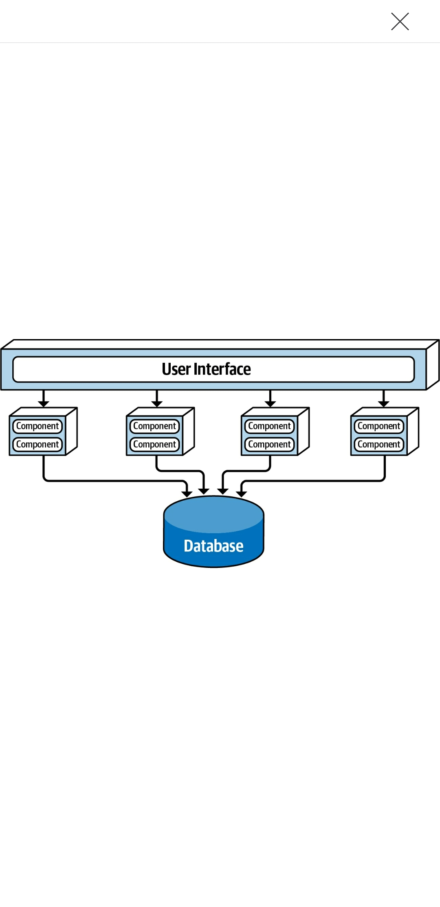
Service-Based architecture - topology

Slide 85
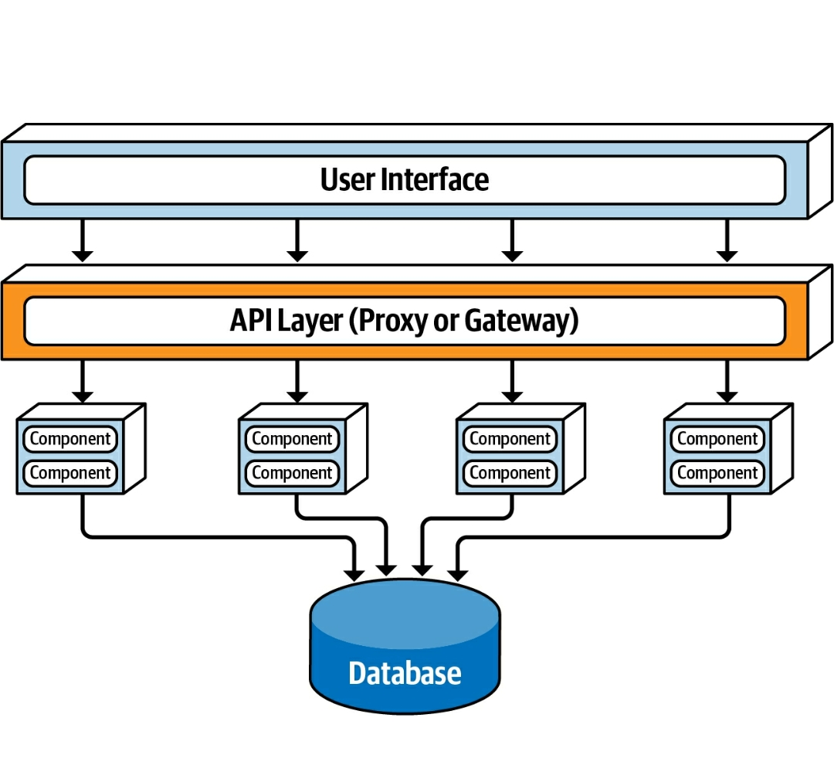
Service-Based architecture – adding layers

Slide 86
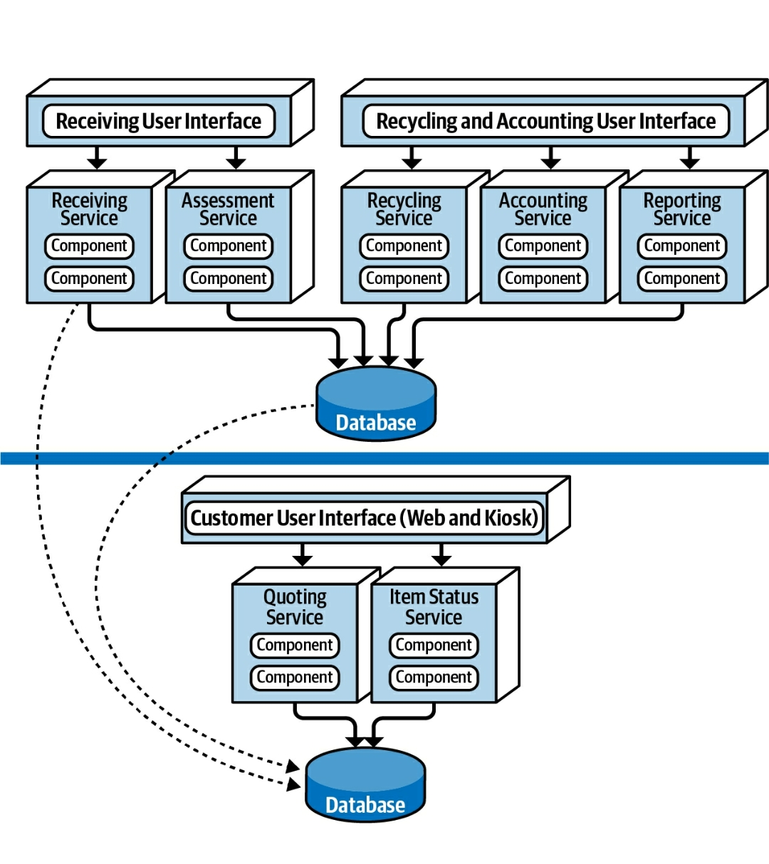
Service-Based architecture – real case

Slide 87
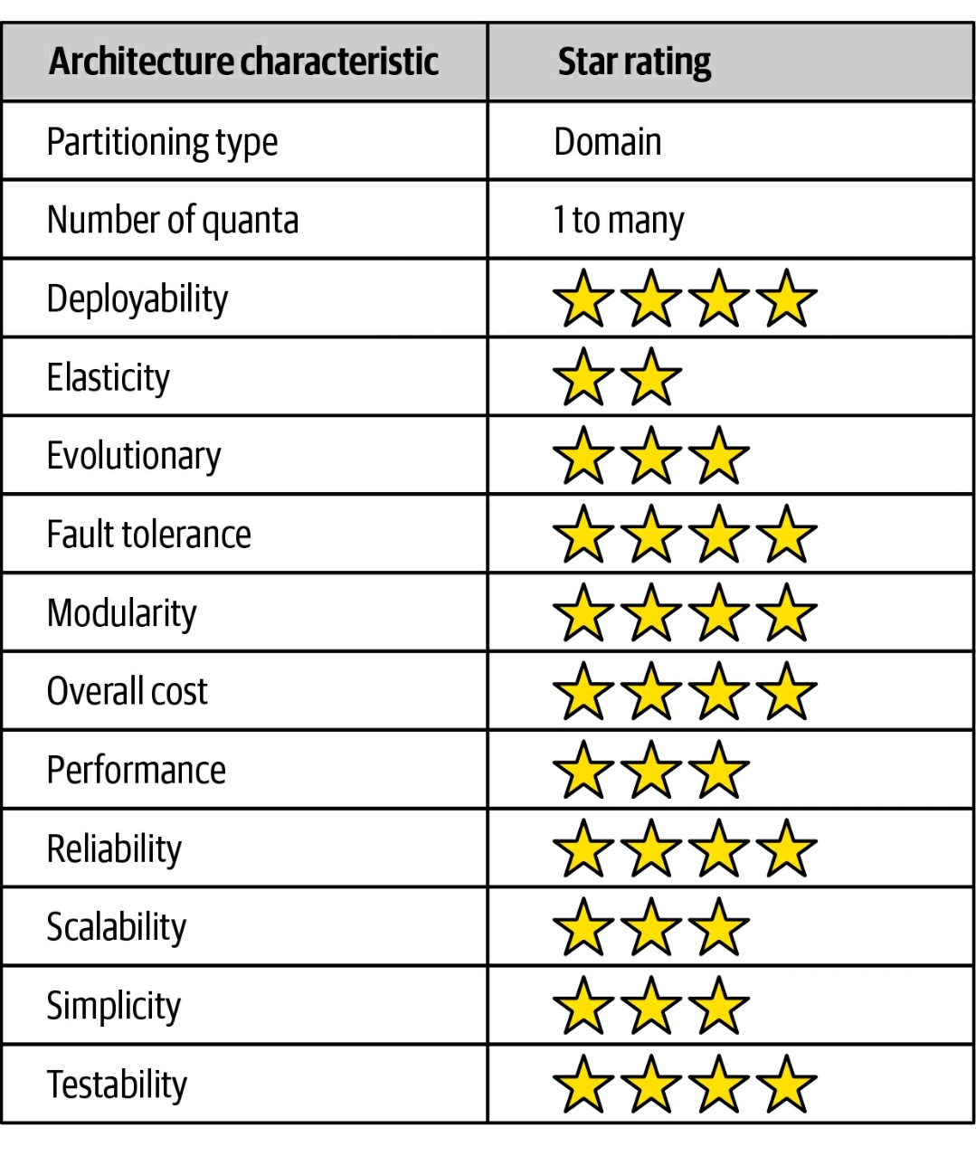
Service-Based architecture – rating

Slide 88
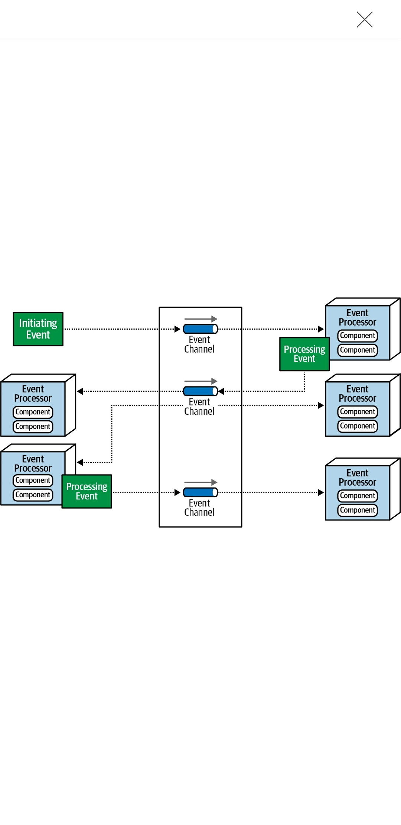
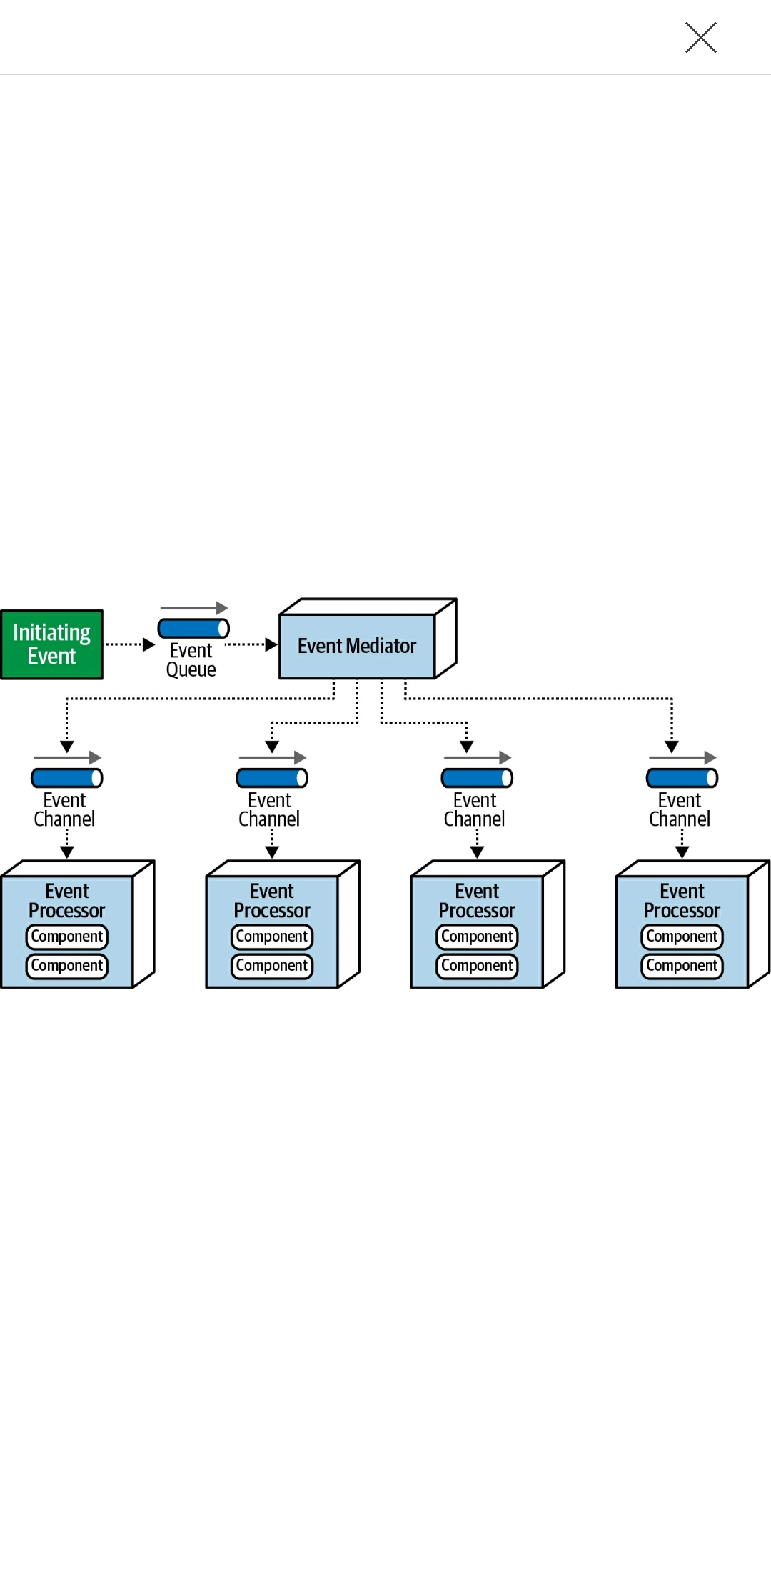
Event-Driven architecture - topology
Broker Topology
Mediator Topology

Slide 89
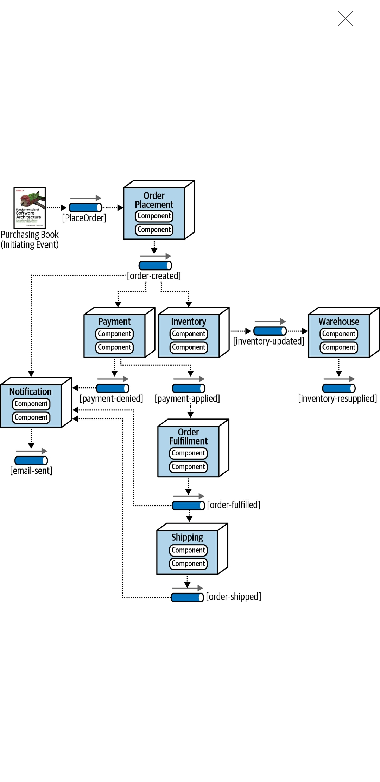
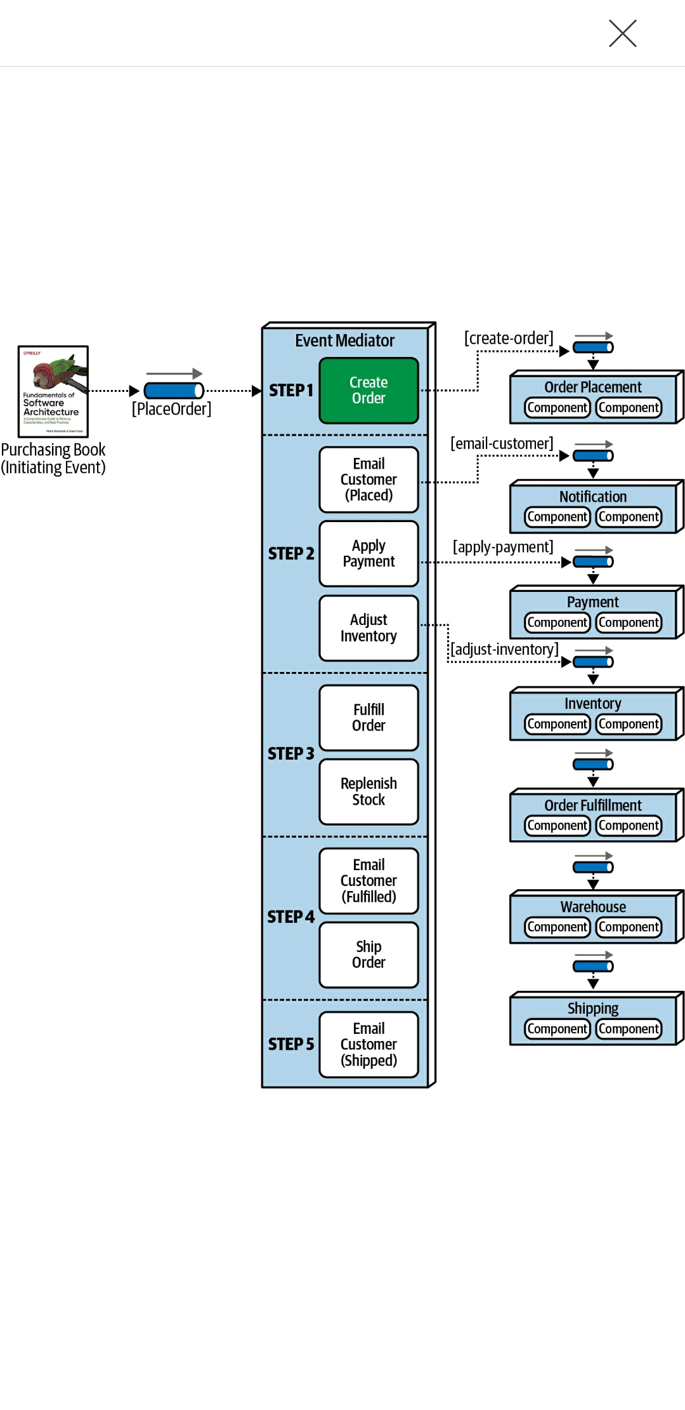
Event-Driven architecture – real case
Broker Topology
Mediator Topology

Slide 90
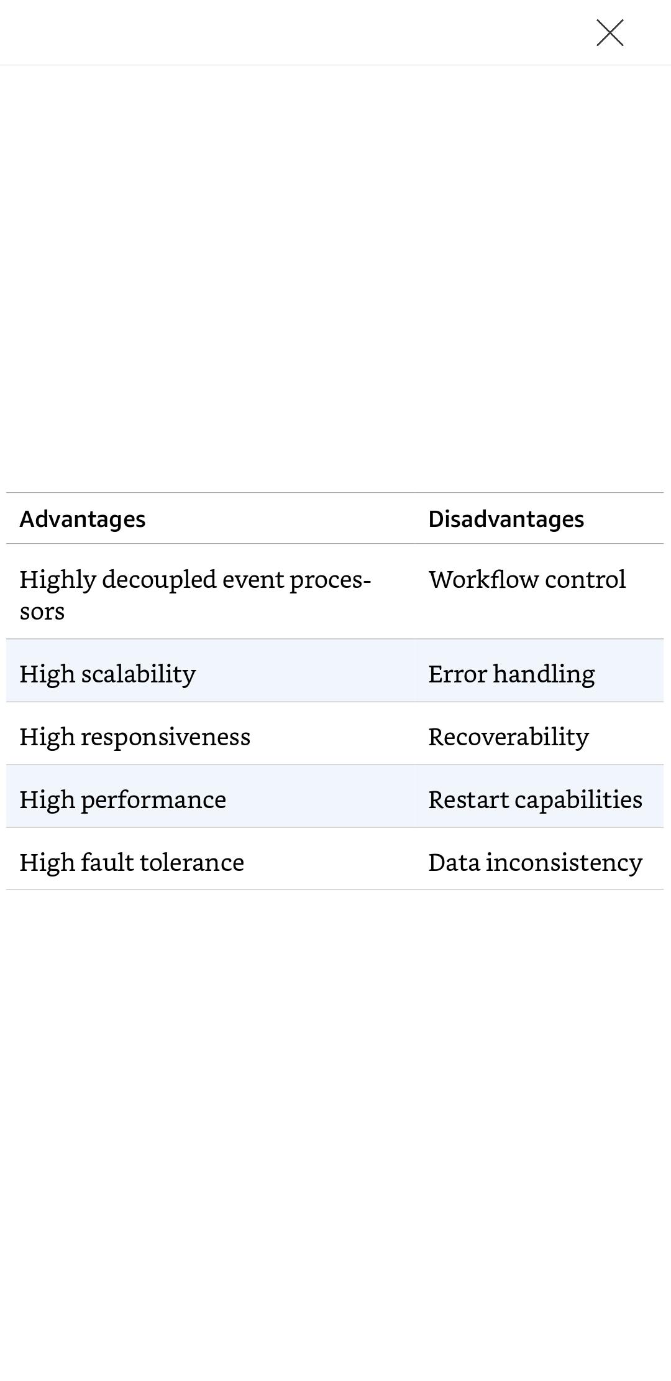
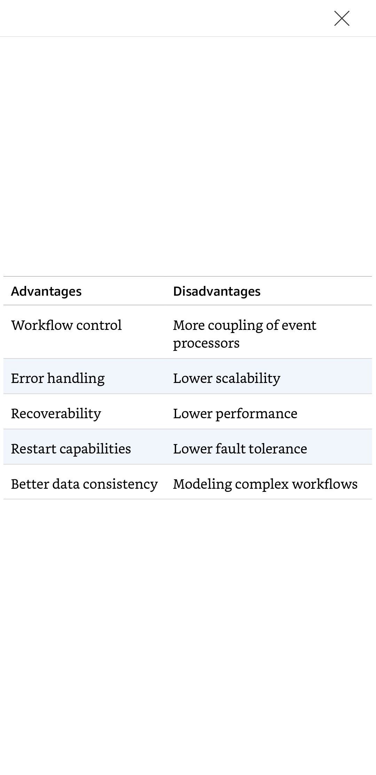
Event-Driven architecture – rating
Broker Topology
Mediator Topology

Slide 91

Event-Driven architecture – rating

Slide 92

Microservice architecture - topology

Slide 93


Microservice architecture – real case

Slide 94

Microservice architecture – rating

Slide 95
Choosing the appropriate architecture
It depends! with all the choices available (and new ones arriving almost daily), we would like to tell you which one to use — but we cannot. Choosing an architecture style represents the culmination of analysis and thought about trade-offs for architecture characteristics, domain considerations, strategic goals, and a host of other things..

Slide 96
Soft skills
“An effective software developer must not only understand the technical aspects of software architecture, but also the primary techniques and soft skills necessary, guide development teams, and effectively communicate the architecture to various stakeholders.”

Slide 97




Analyzing architecture risk
1
2
3
4

Slide 98

Analyzing architecture risk

Slide 99

Diagramming and presenting architecture
Architecture Decision Records
https://xblocks.socgen/icd/demo/#/client/awt-v4-architecture-front-react.md

Slide 100

Checklists

Slide 101
04
CONCLUSION
Lessons learned & summary.

Slide 102
The future is here …

Slide 103
THANKS!
Do you have any questions?
https://helabenkhalfallah.medium.com/
Twitter : b_k_hela
You don't have to be a "Googley" to make good code and good architecture, it's all about "motivation" and "culture".

